Slide 1
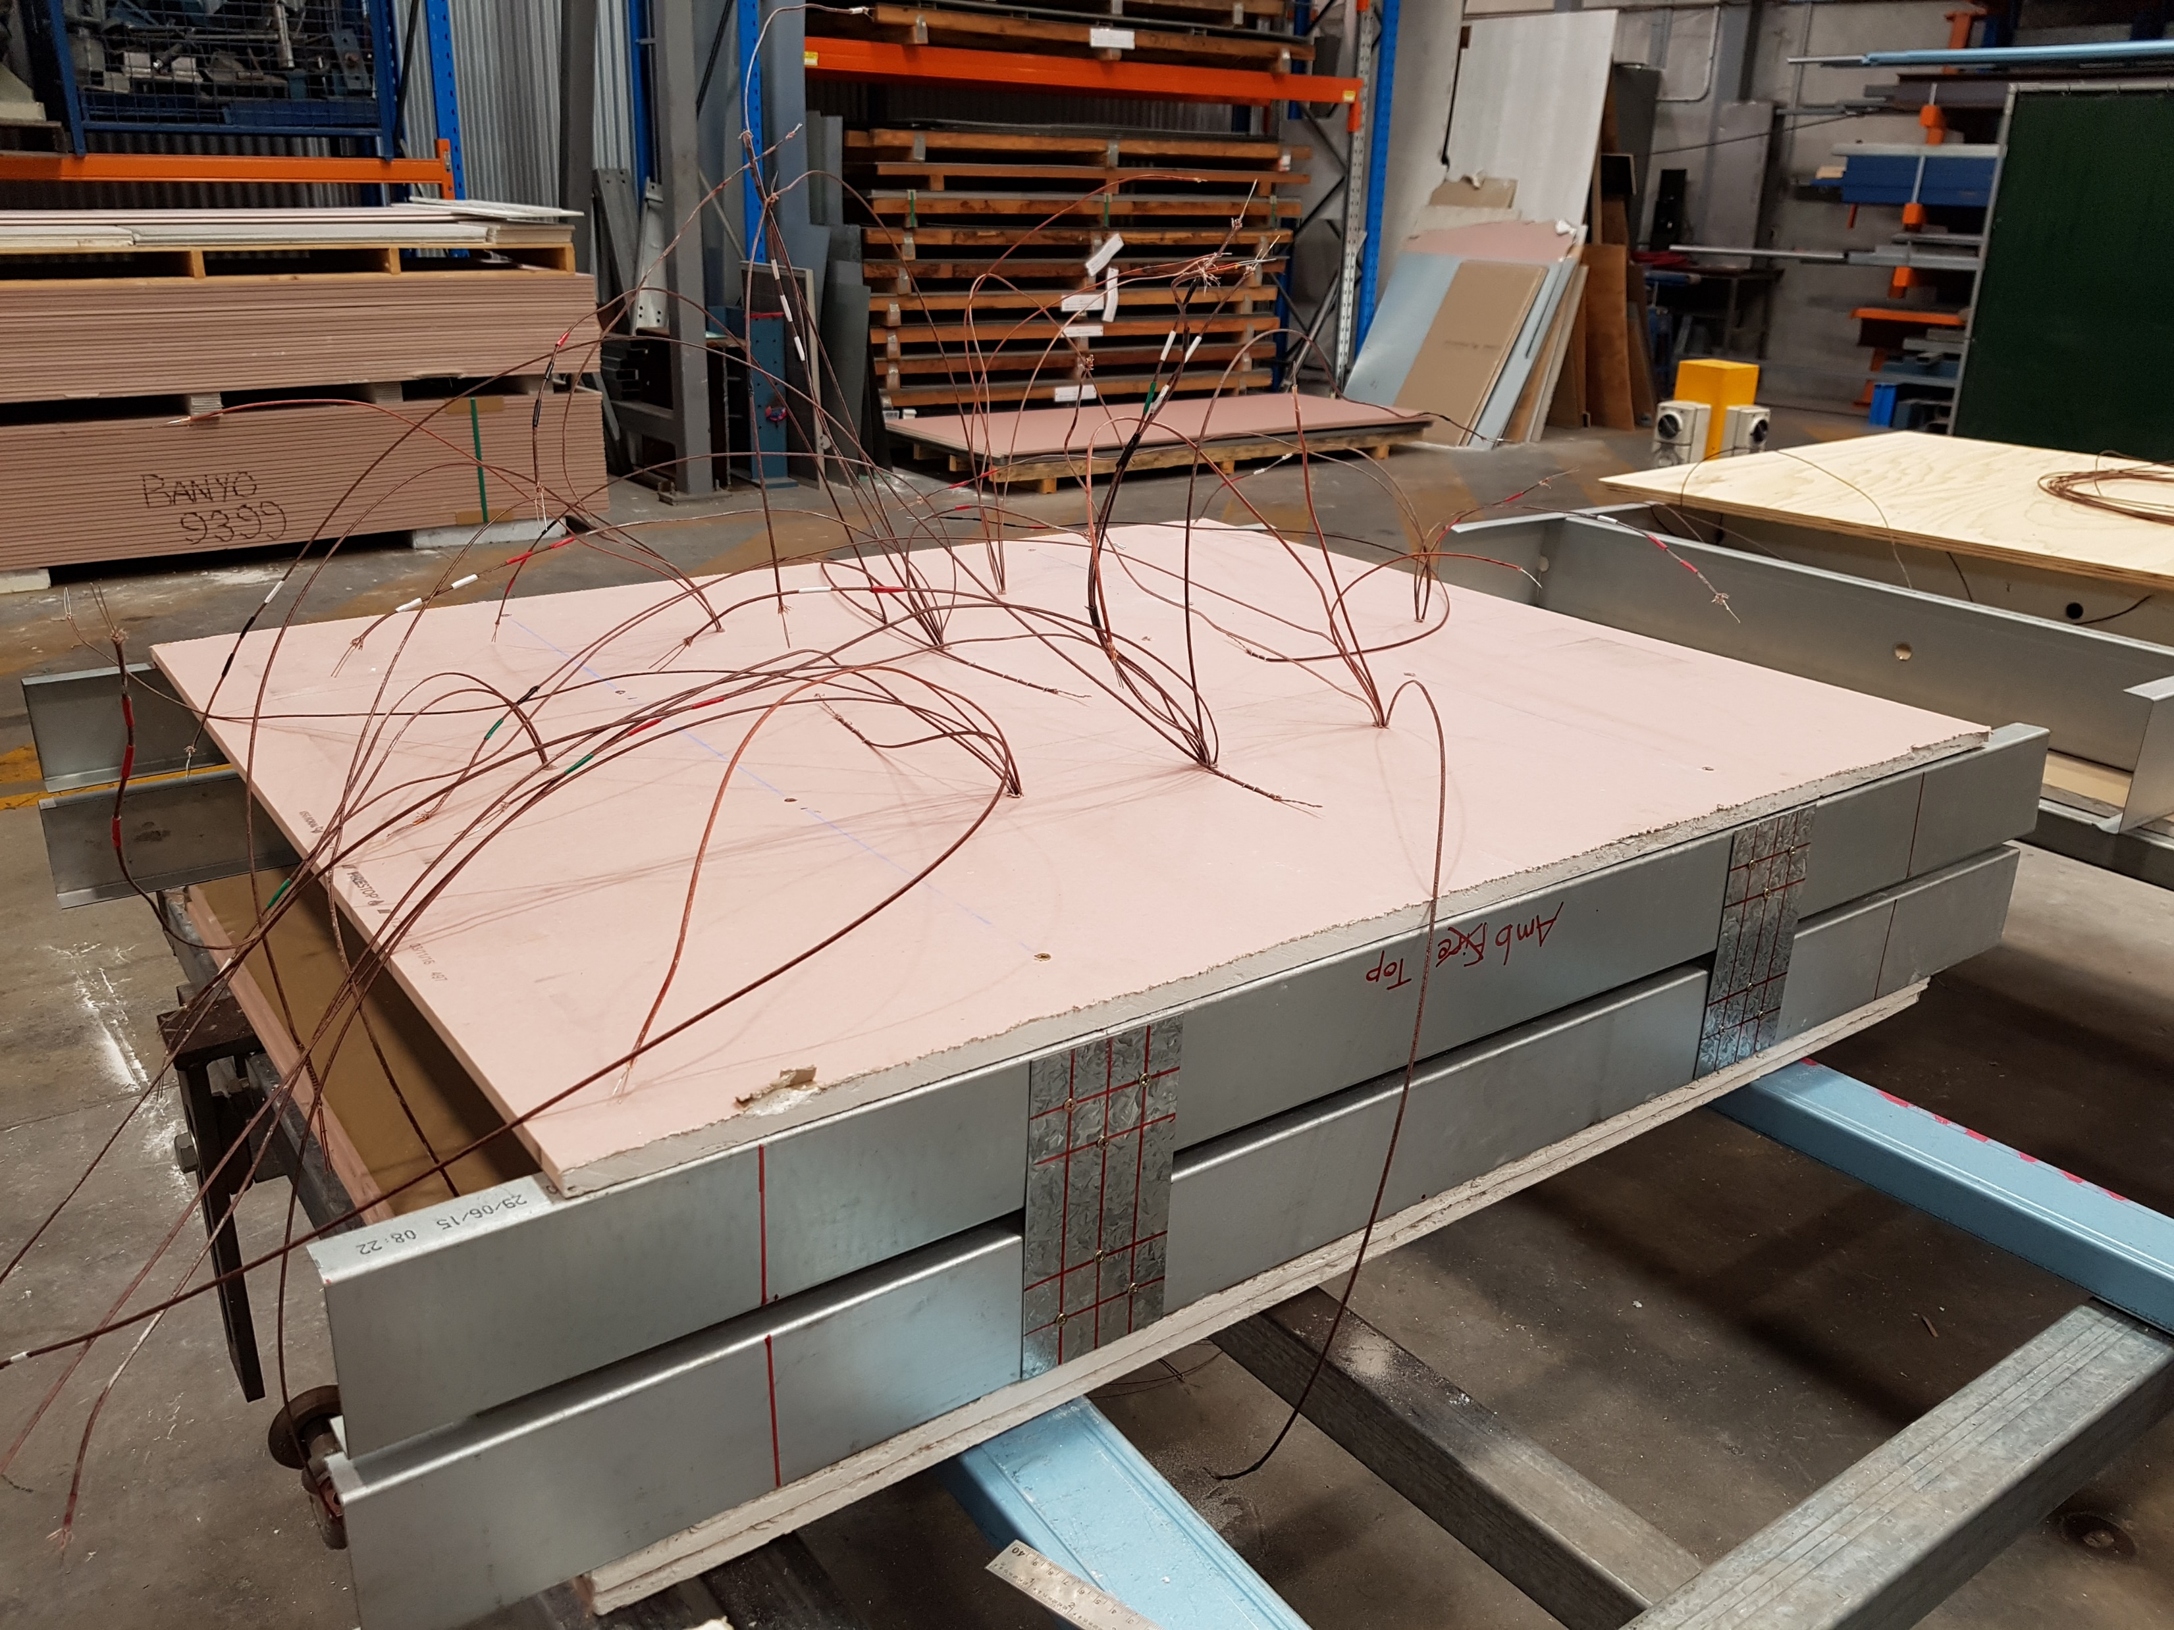
Thermocouples
Plasterboard
Tracks
Tracks
Spacer Plates at Stud Locations
Notes:
Small-scale - construction

Slide 2
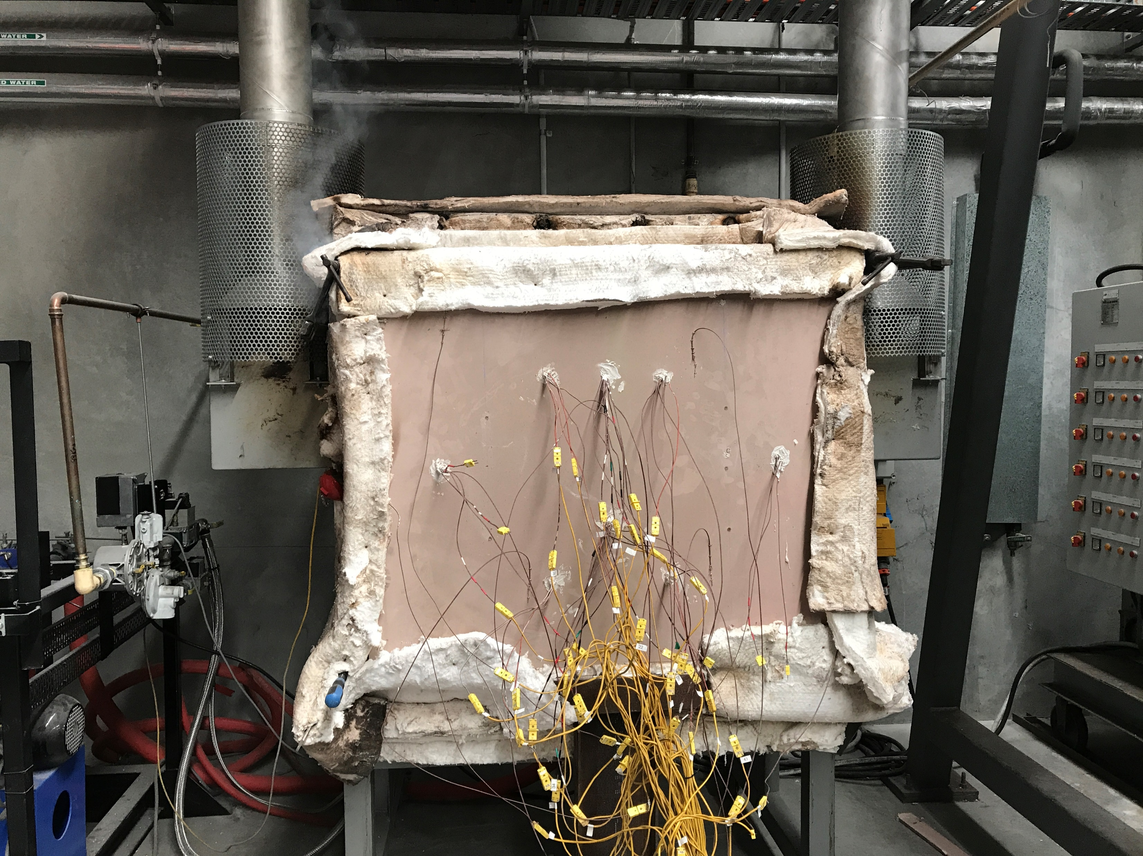
Exhaust
1 m
Supporting Clamps
1 m
Ambient Plasterboard
Thermocouples
Furnace Controller
Notes:
Small-scale – set-up

Slide 3
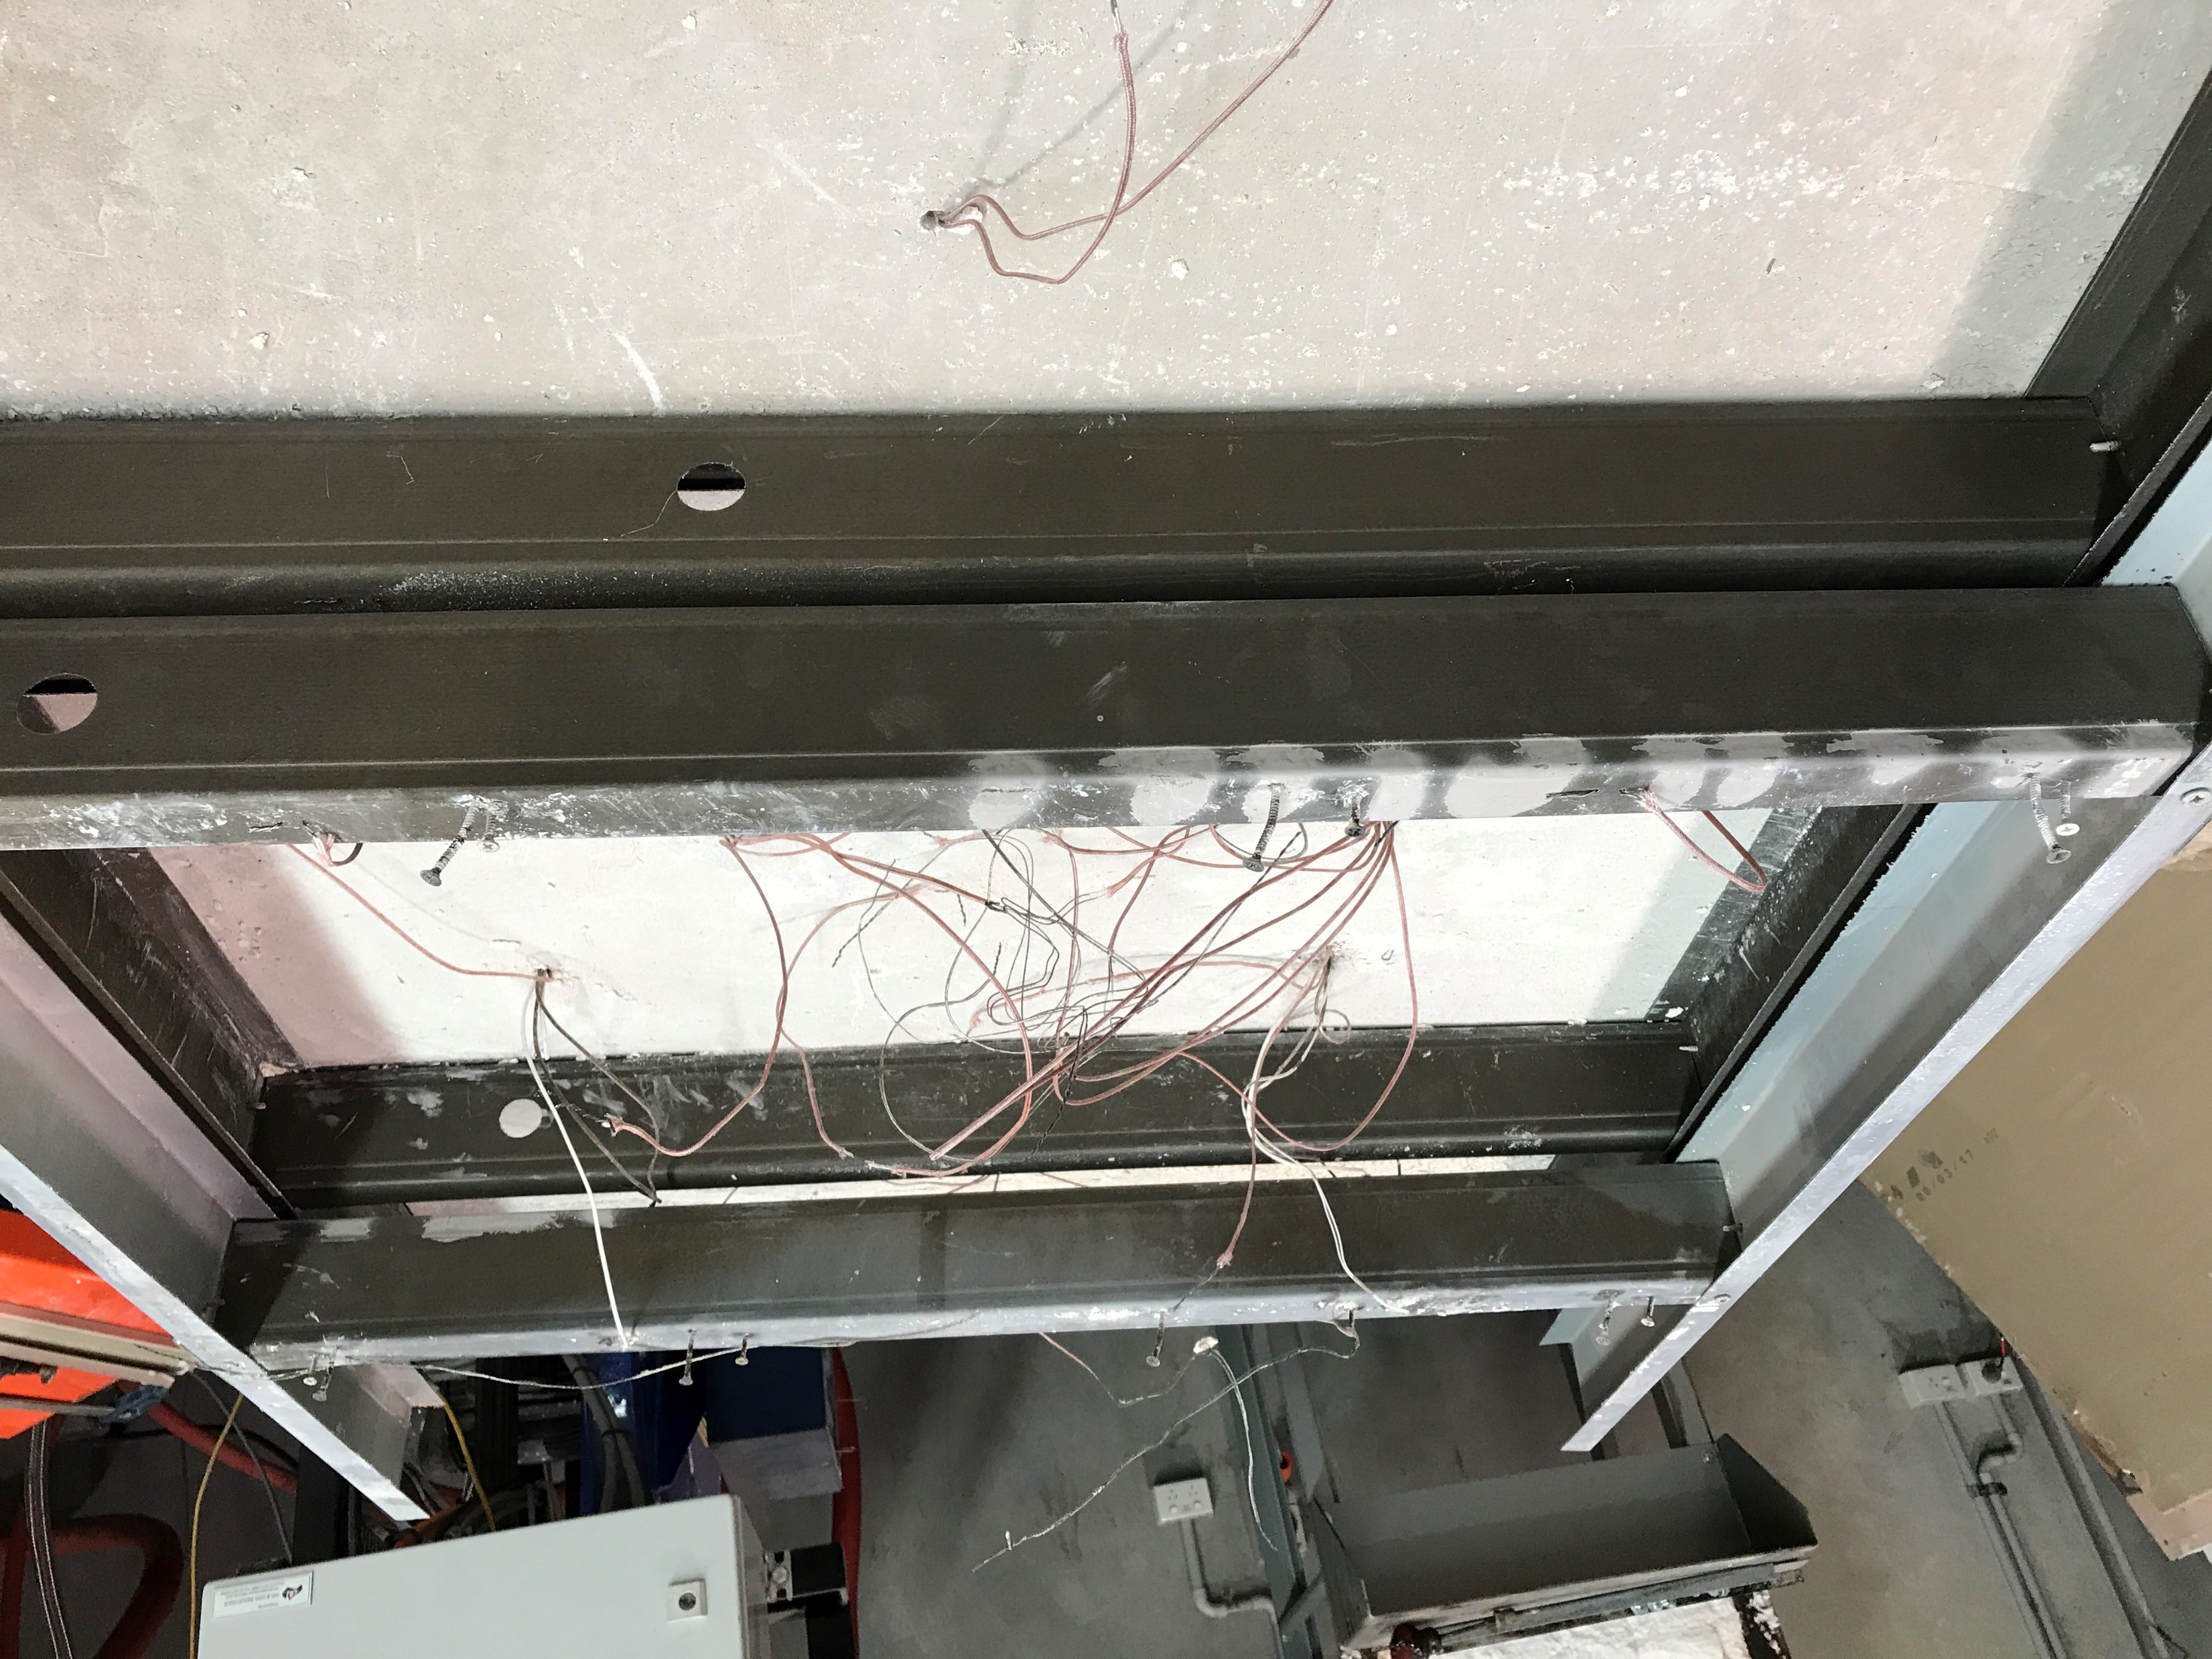
Studs After Fire Test
Fire-HF
Fire-CF
Amb-HF
Amb-CF
Notes:
Small scale – post testing

Slide 4
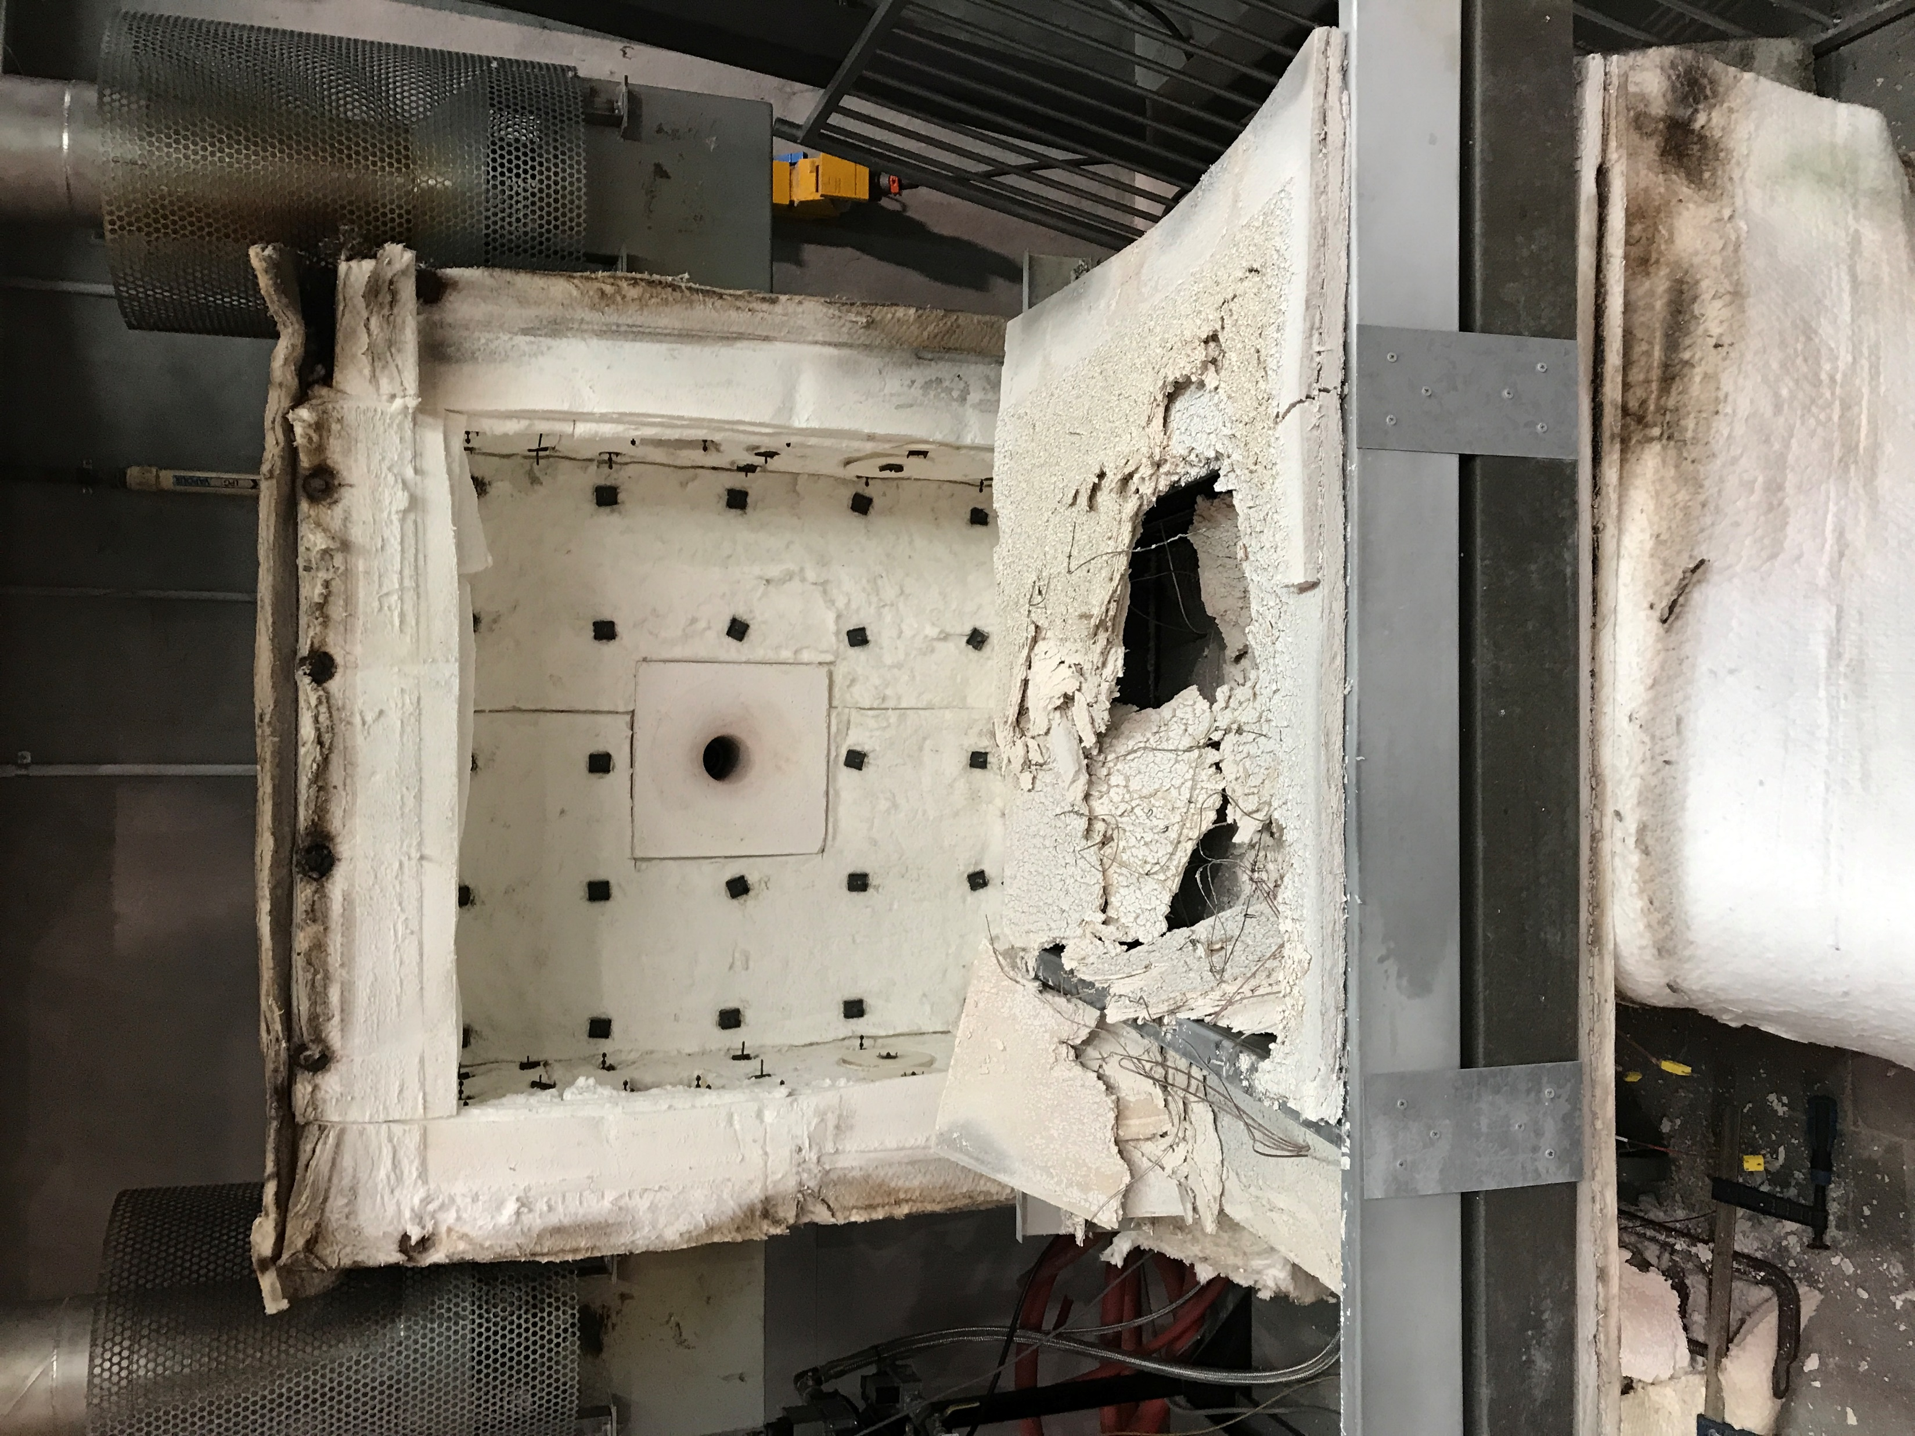
Fire Side
Plasterboard
Fall-Off
Furnace
Burner

Slide 5
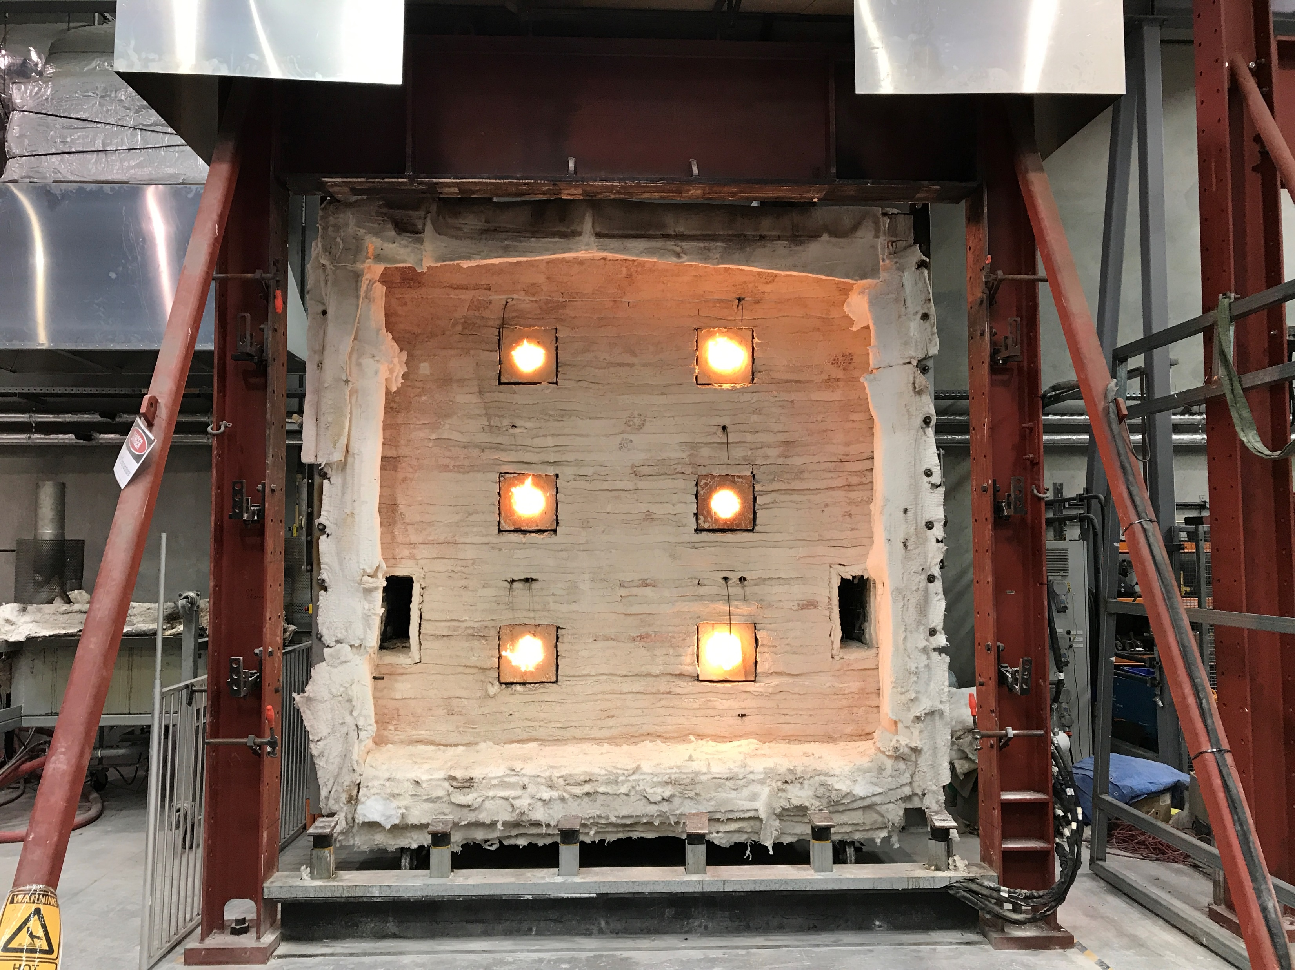
Top Beam (WB)
Universal Column (UC)
Universal Column (UC)
Gas Burners
Rams and Loading Plates
Bottom Beam (UB)

Slide 6
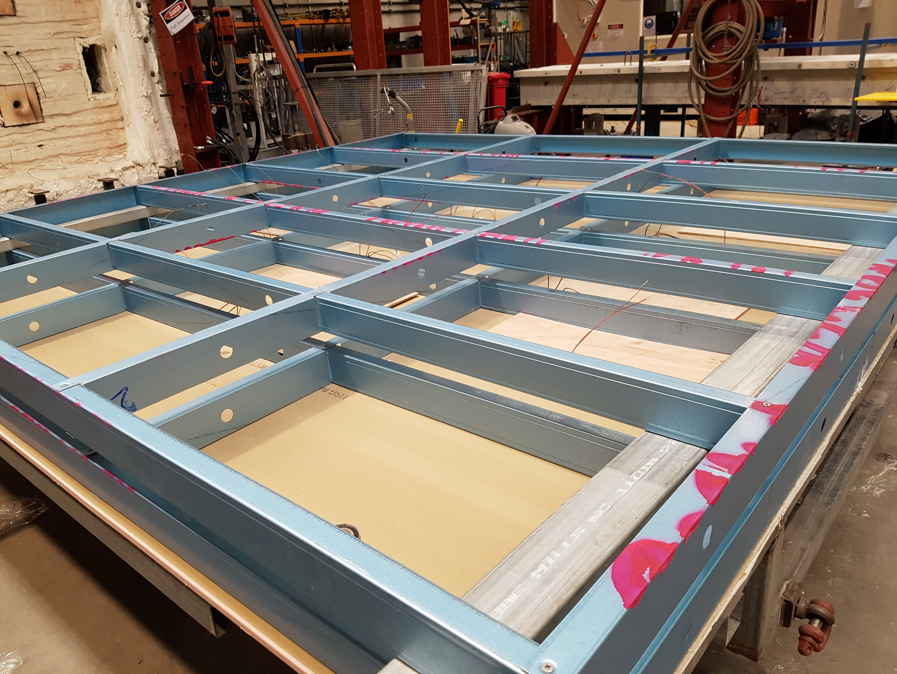
Nogging-Row1
Stud-Row1
Nogging-Row2
Track-Row1
Stud-Row2
Plasterboard
Track-Row2
Notes:
T1-T4-construction

Slide 7
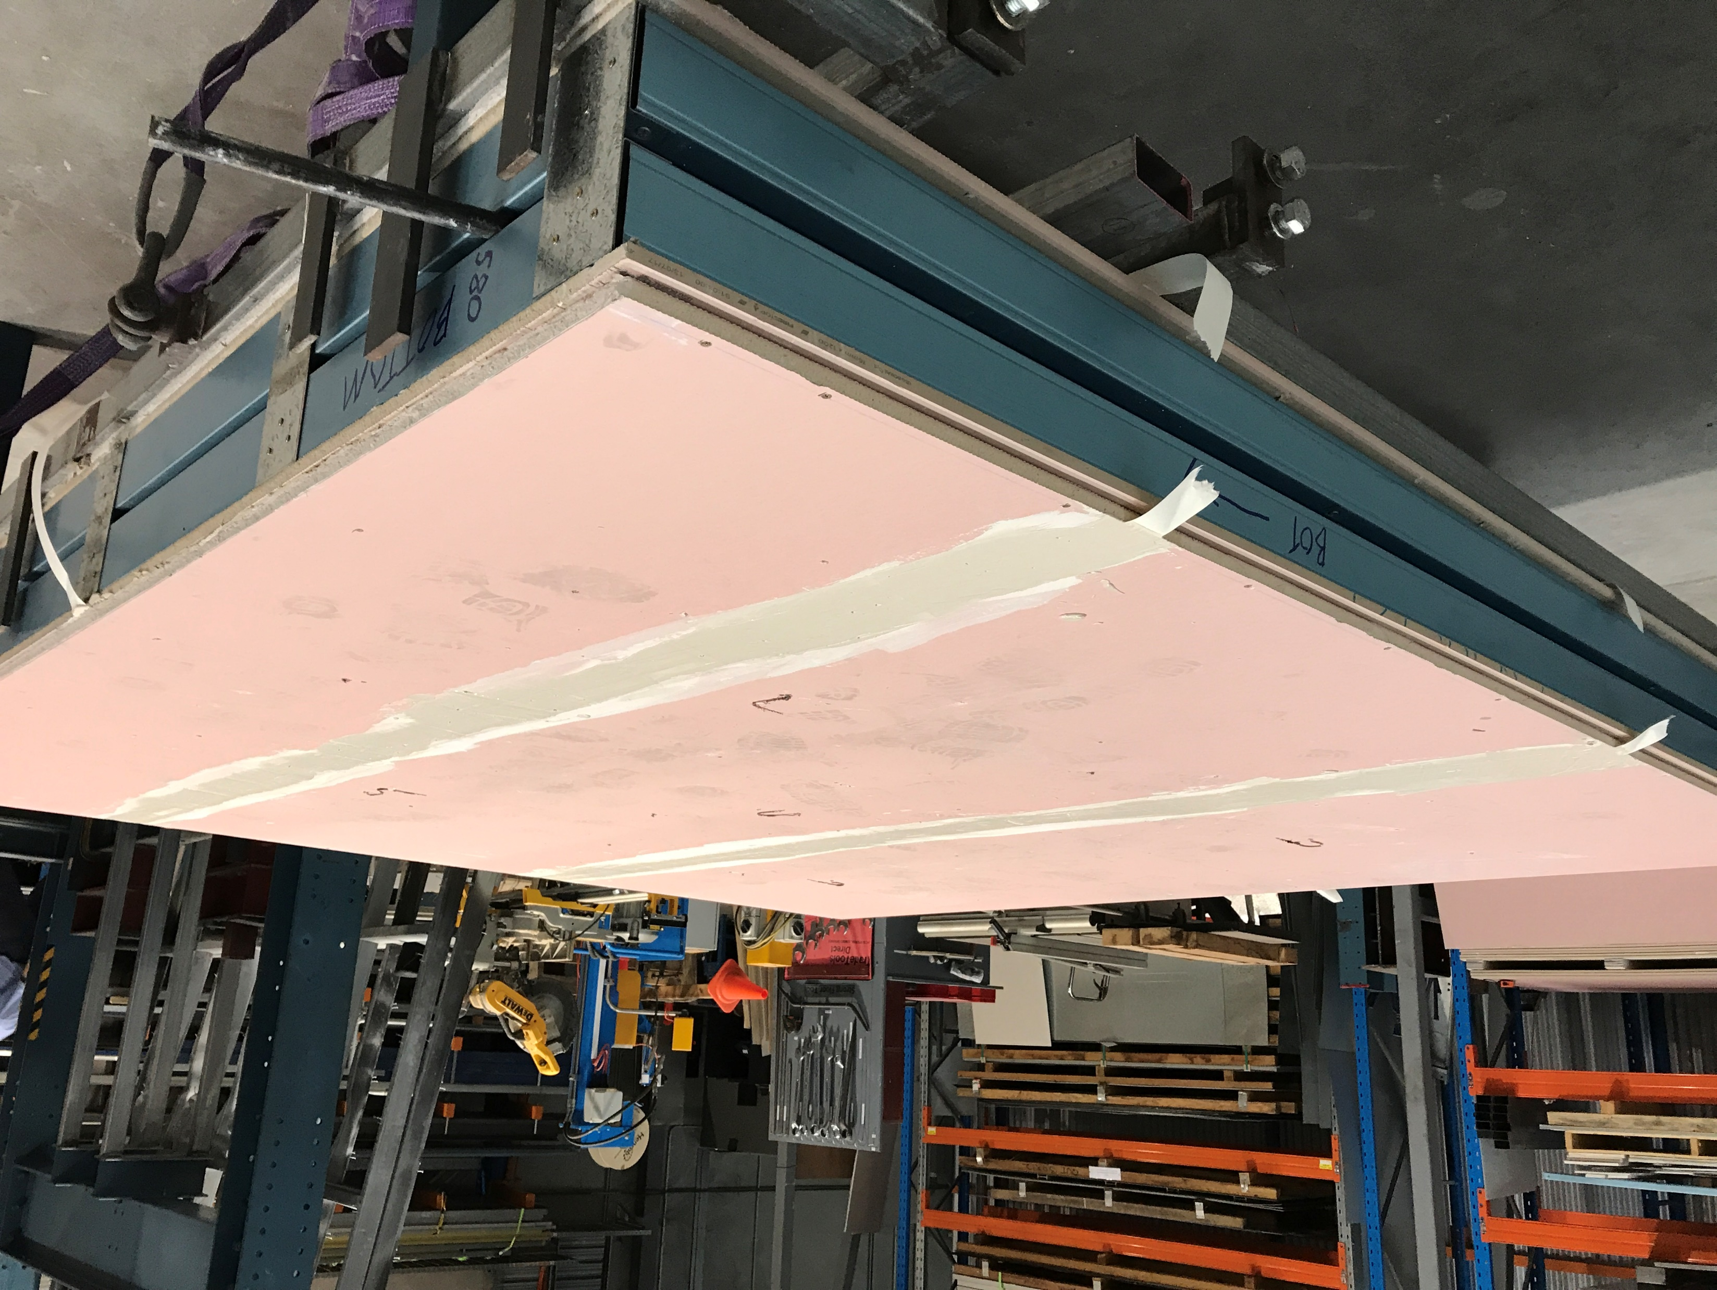
Plasterboard joint
Stud-Row1
Plasterboard
Stud-Row2
Constructed test wall
Notes:
T1-T4 full built

Slide 8
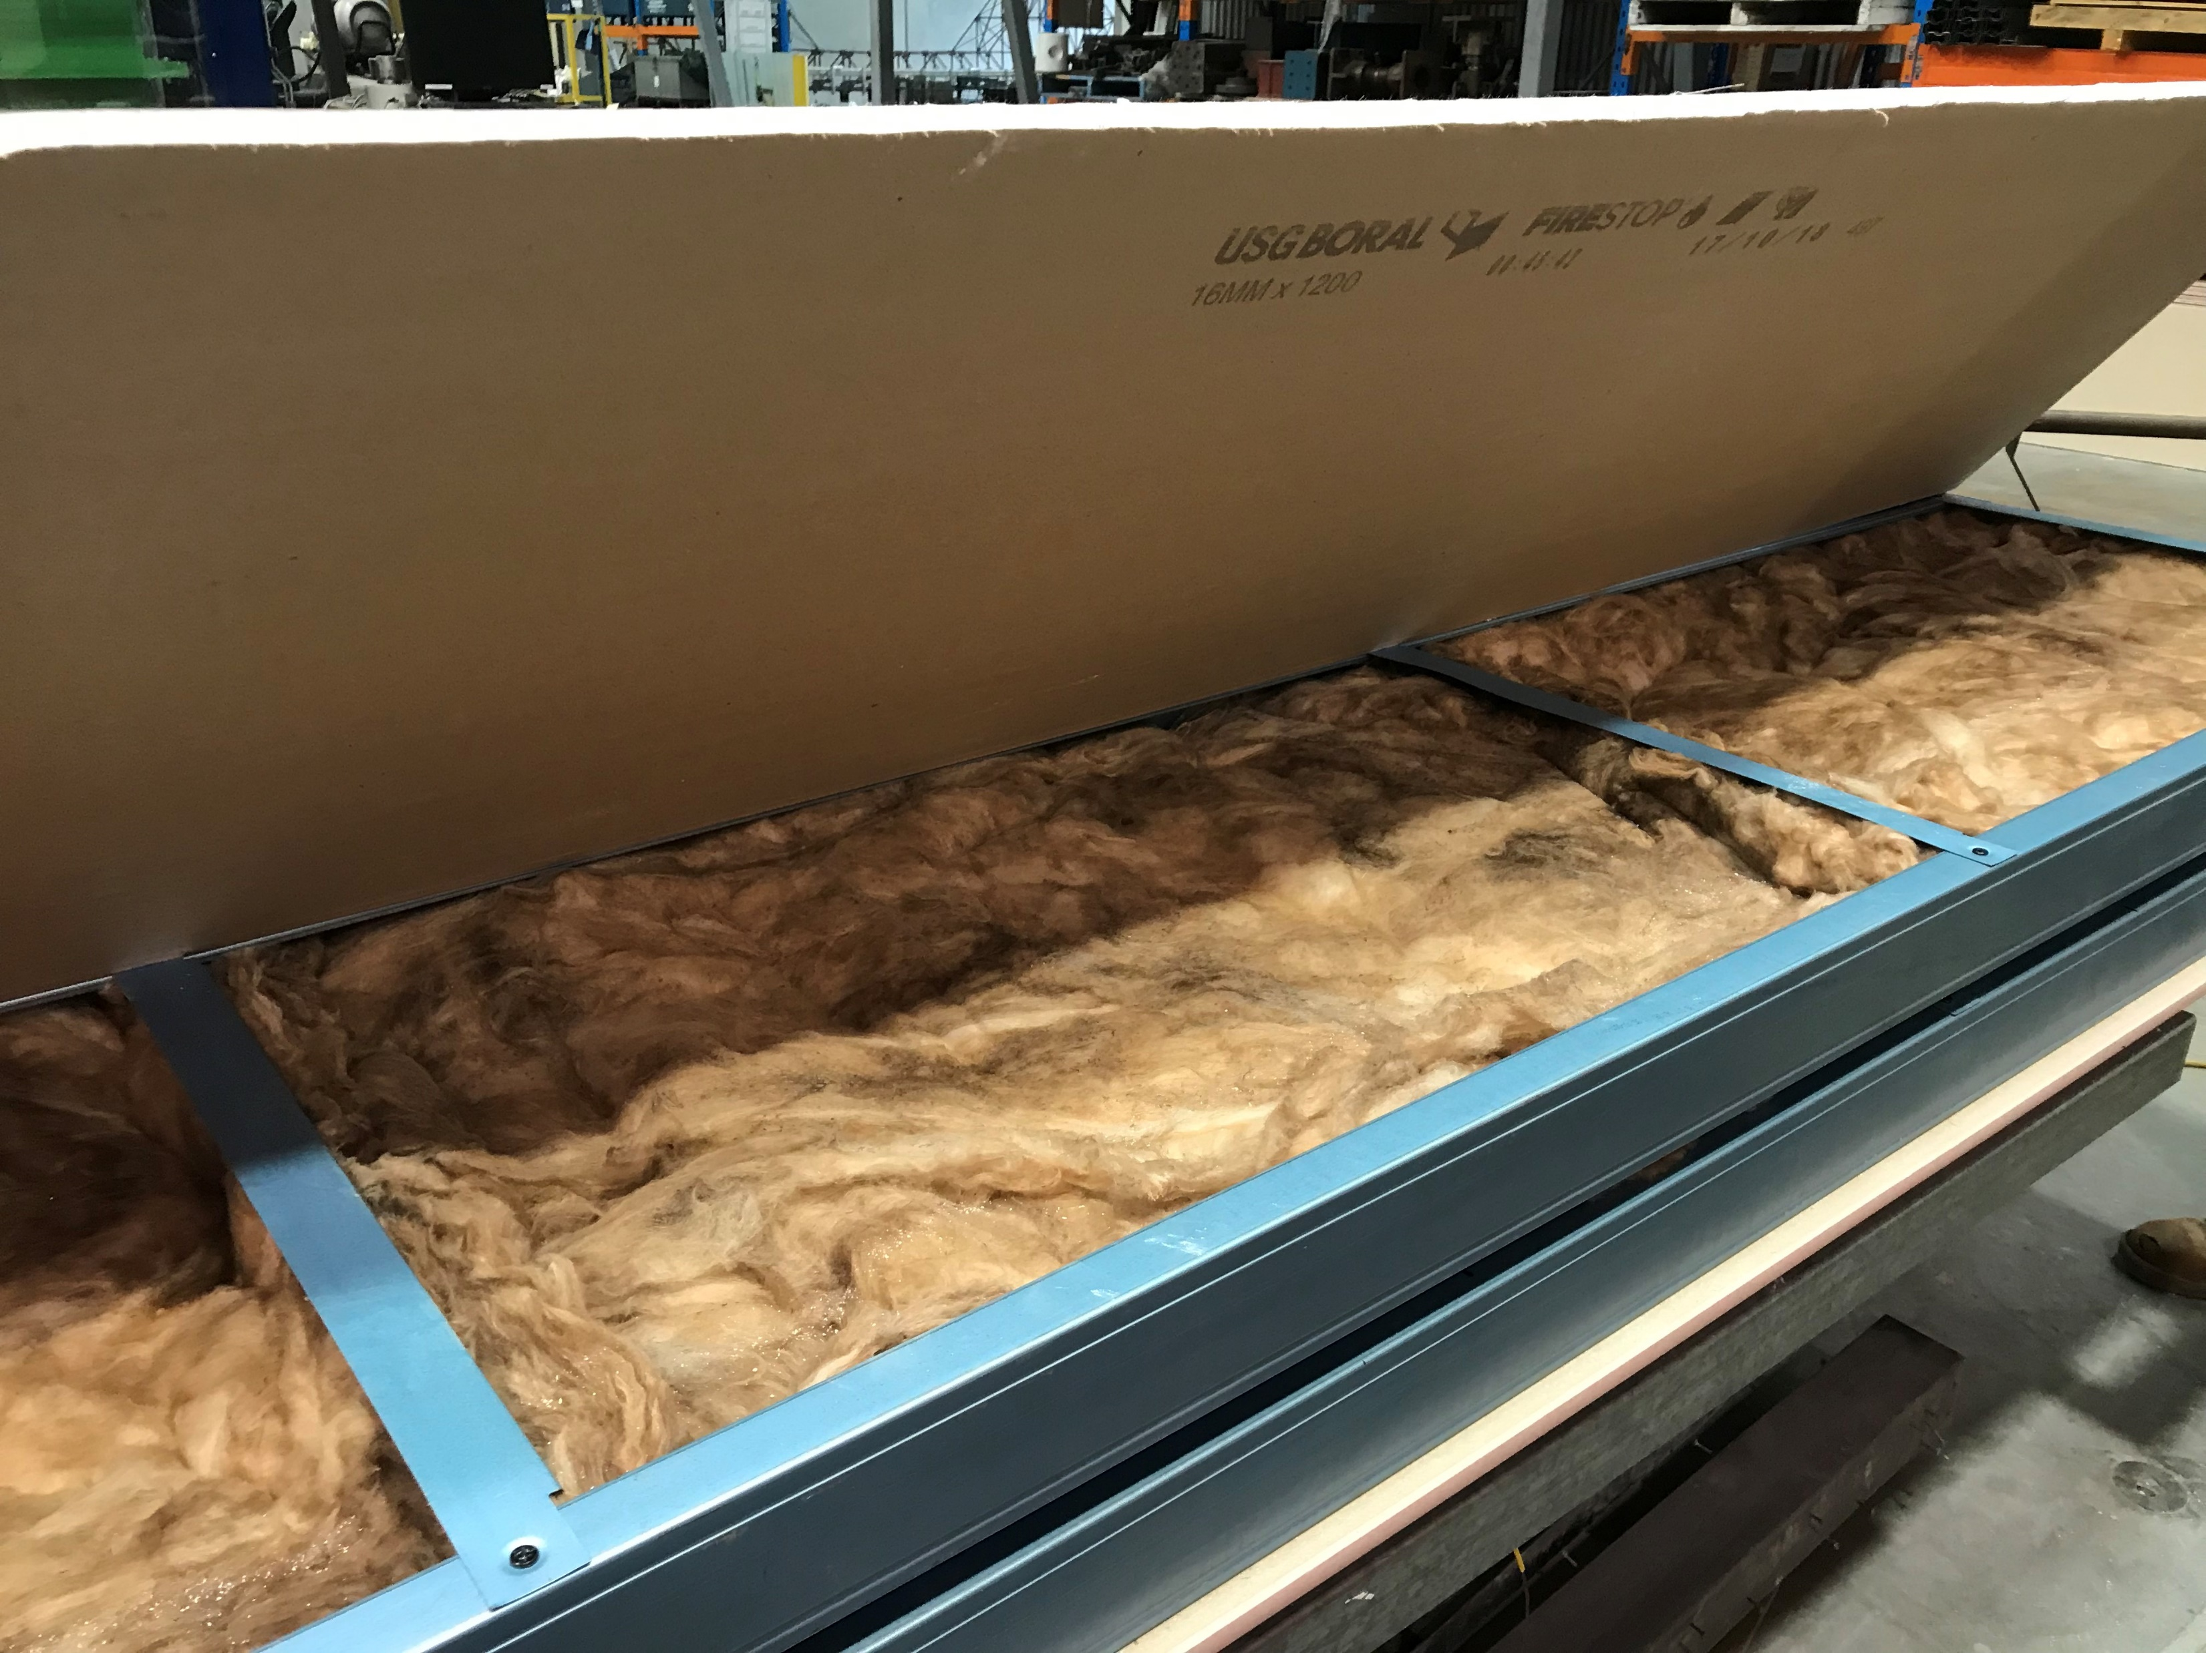
Plasterboard
Nogging
Glass Fibre Insulation
Stud Row-1
Stud Row-2
Notes:
T5-T6construction

Slide 9
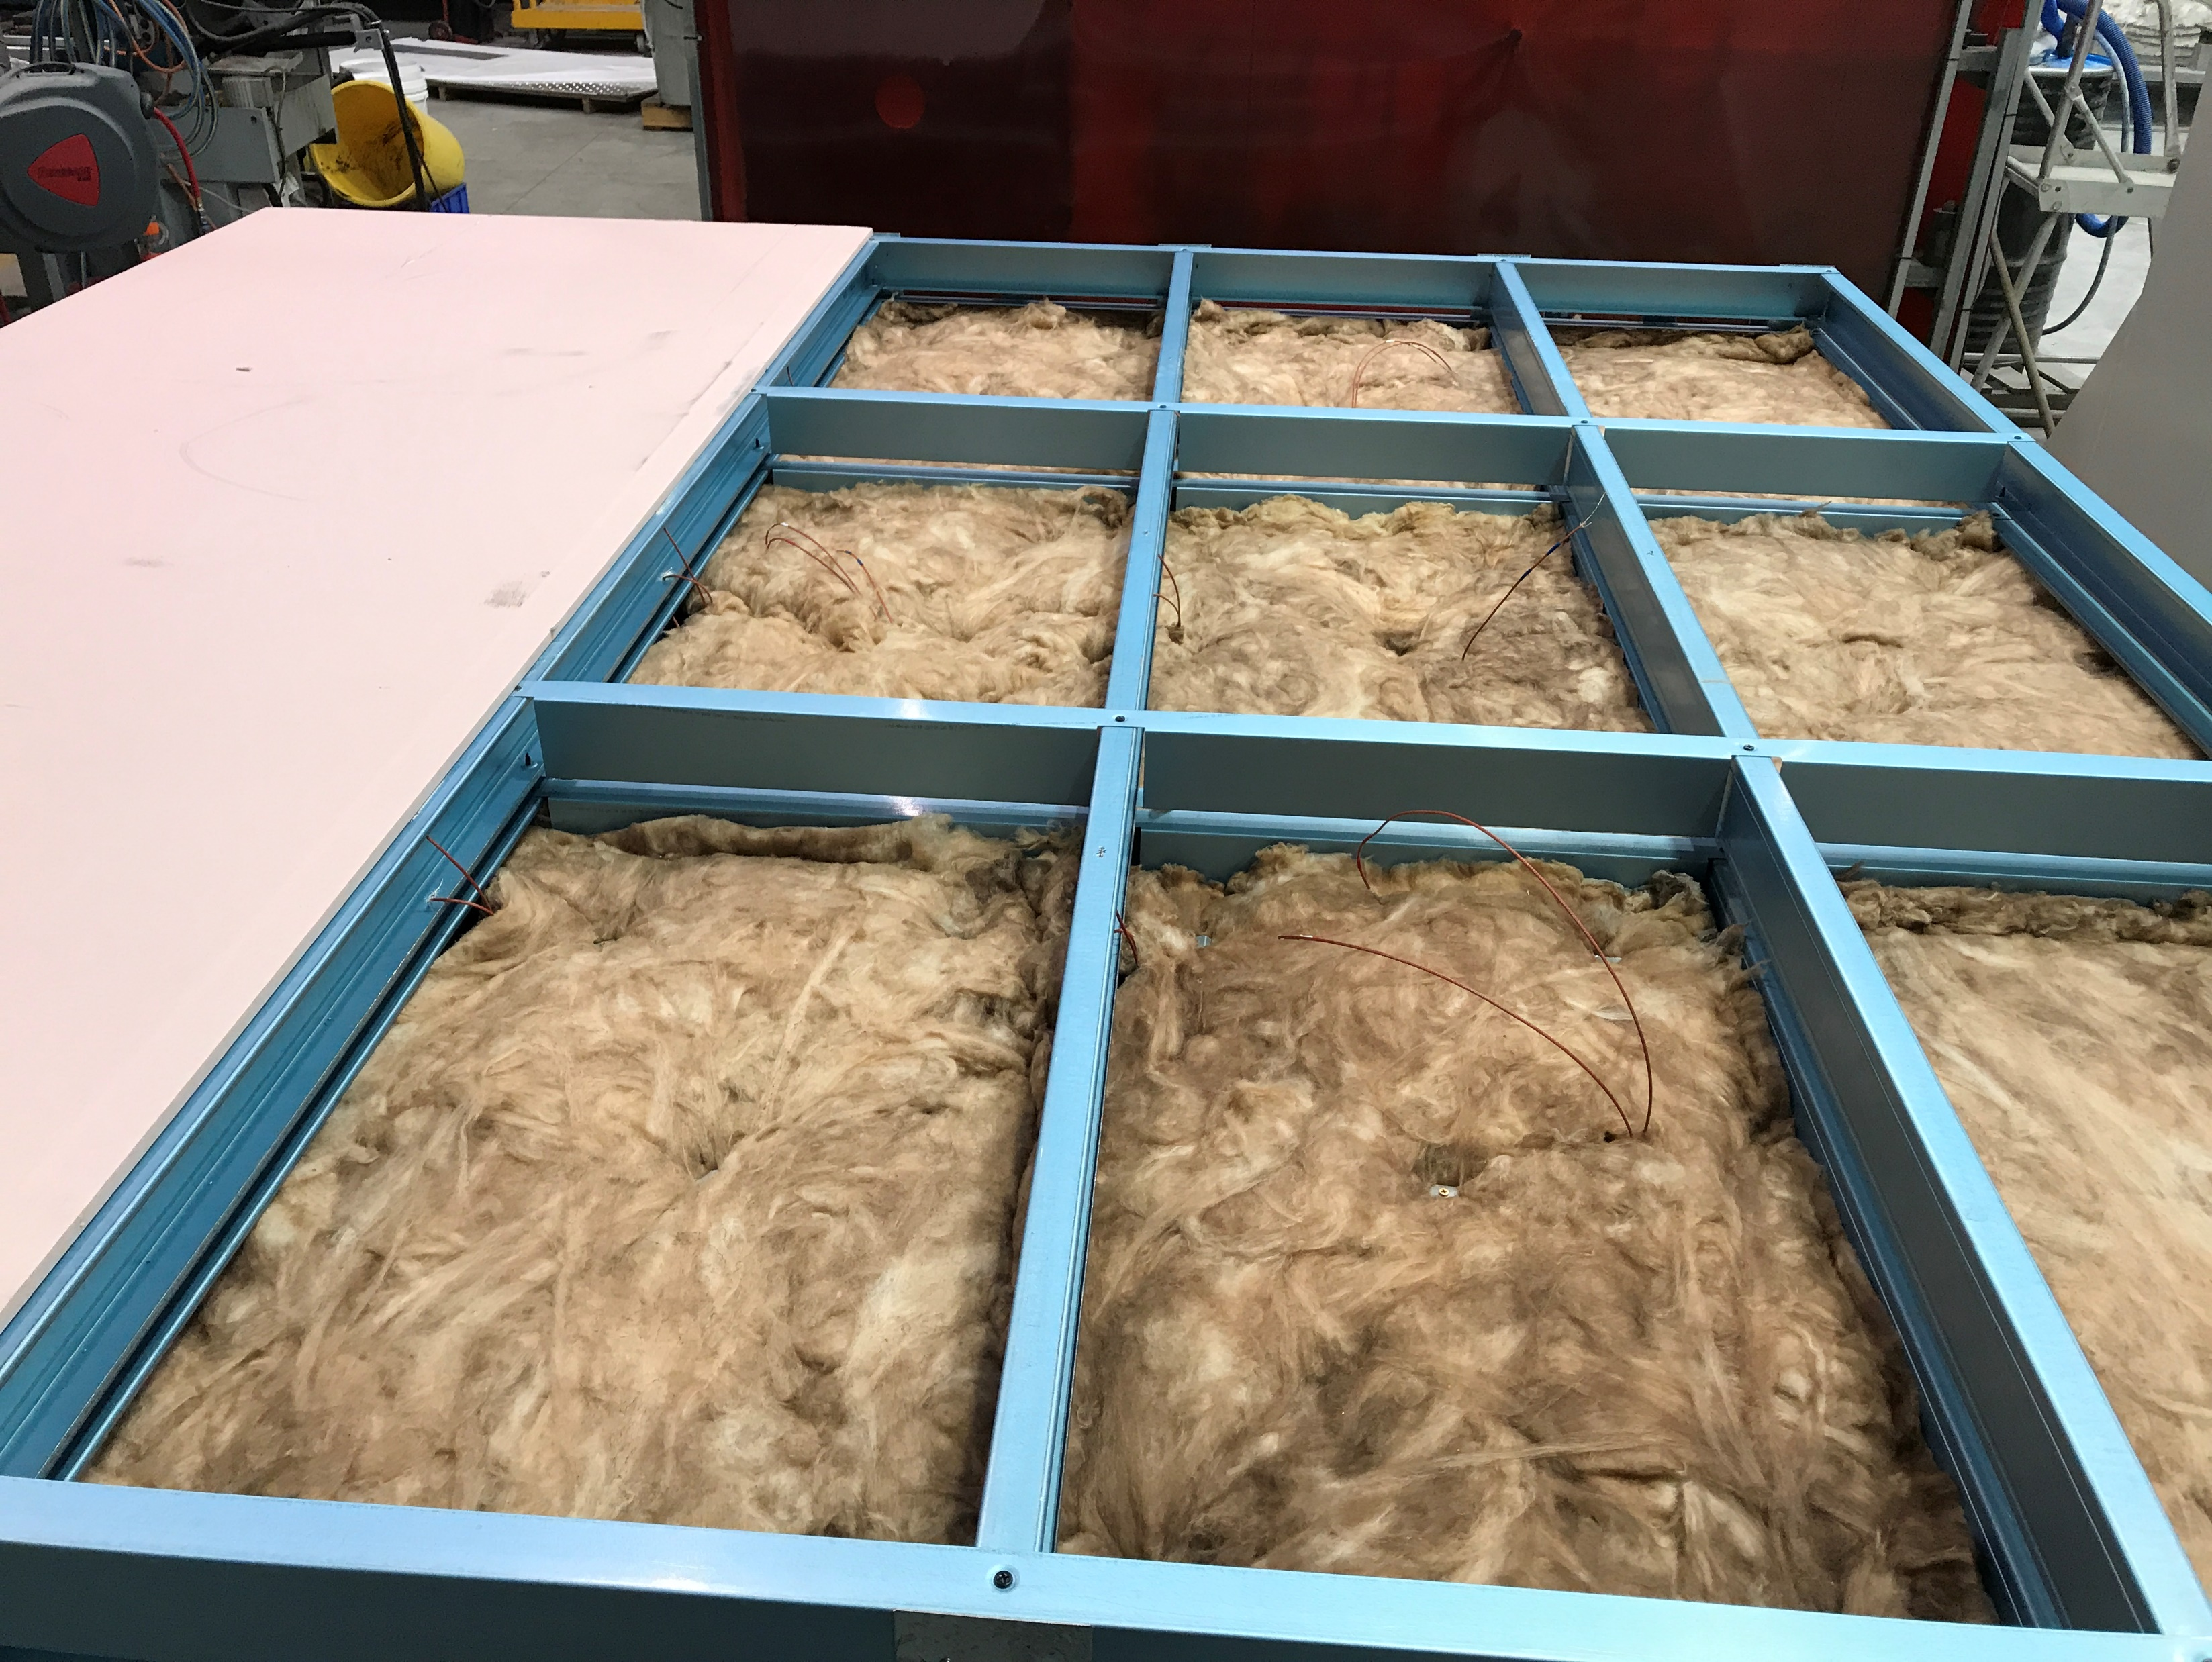
Track-Row1
Plasterboard
Nogging
Glass Fibre Insulation – Ambient side
Stud Row-1
Stud Row-2

Slide 10
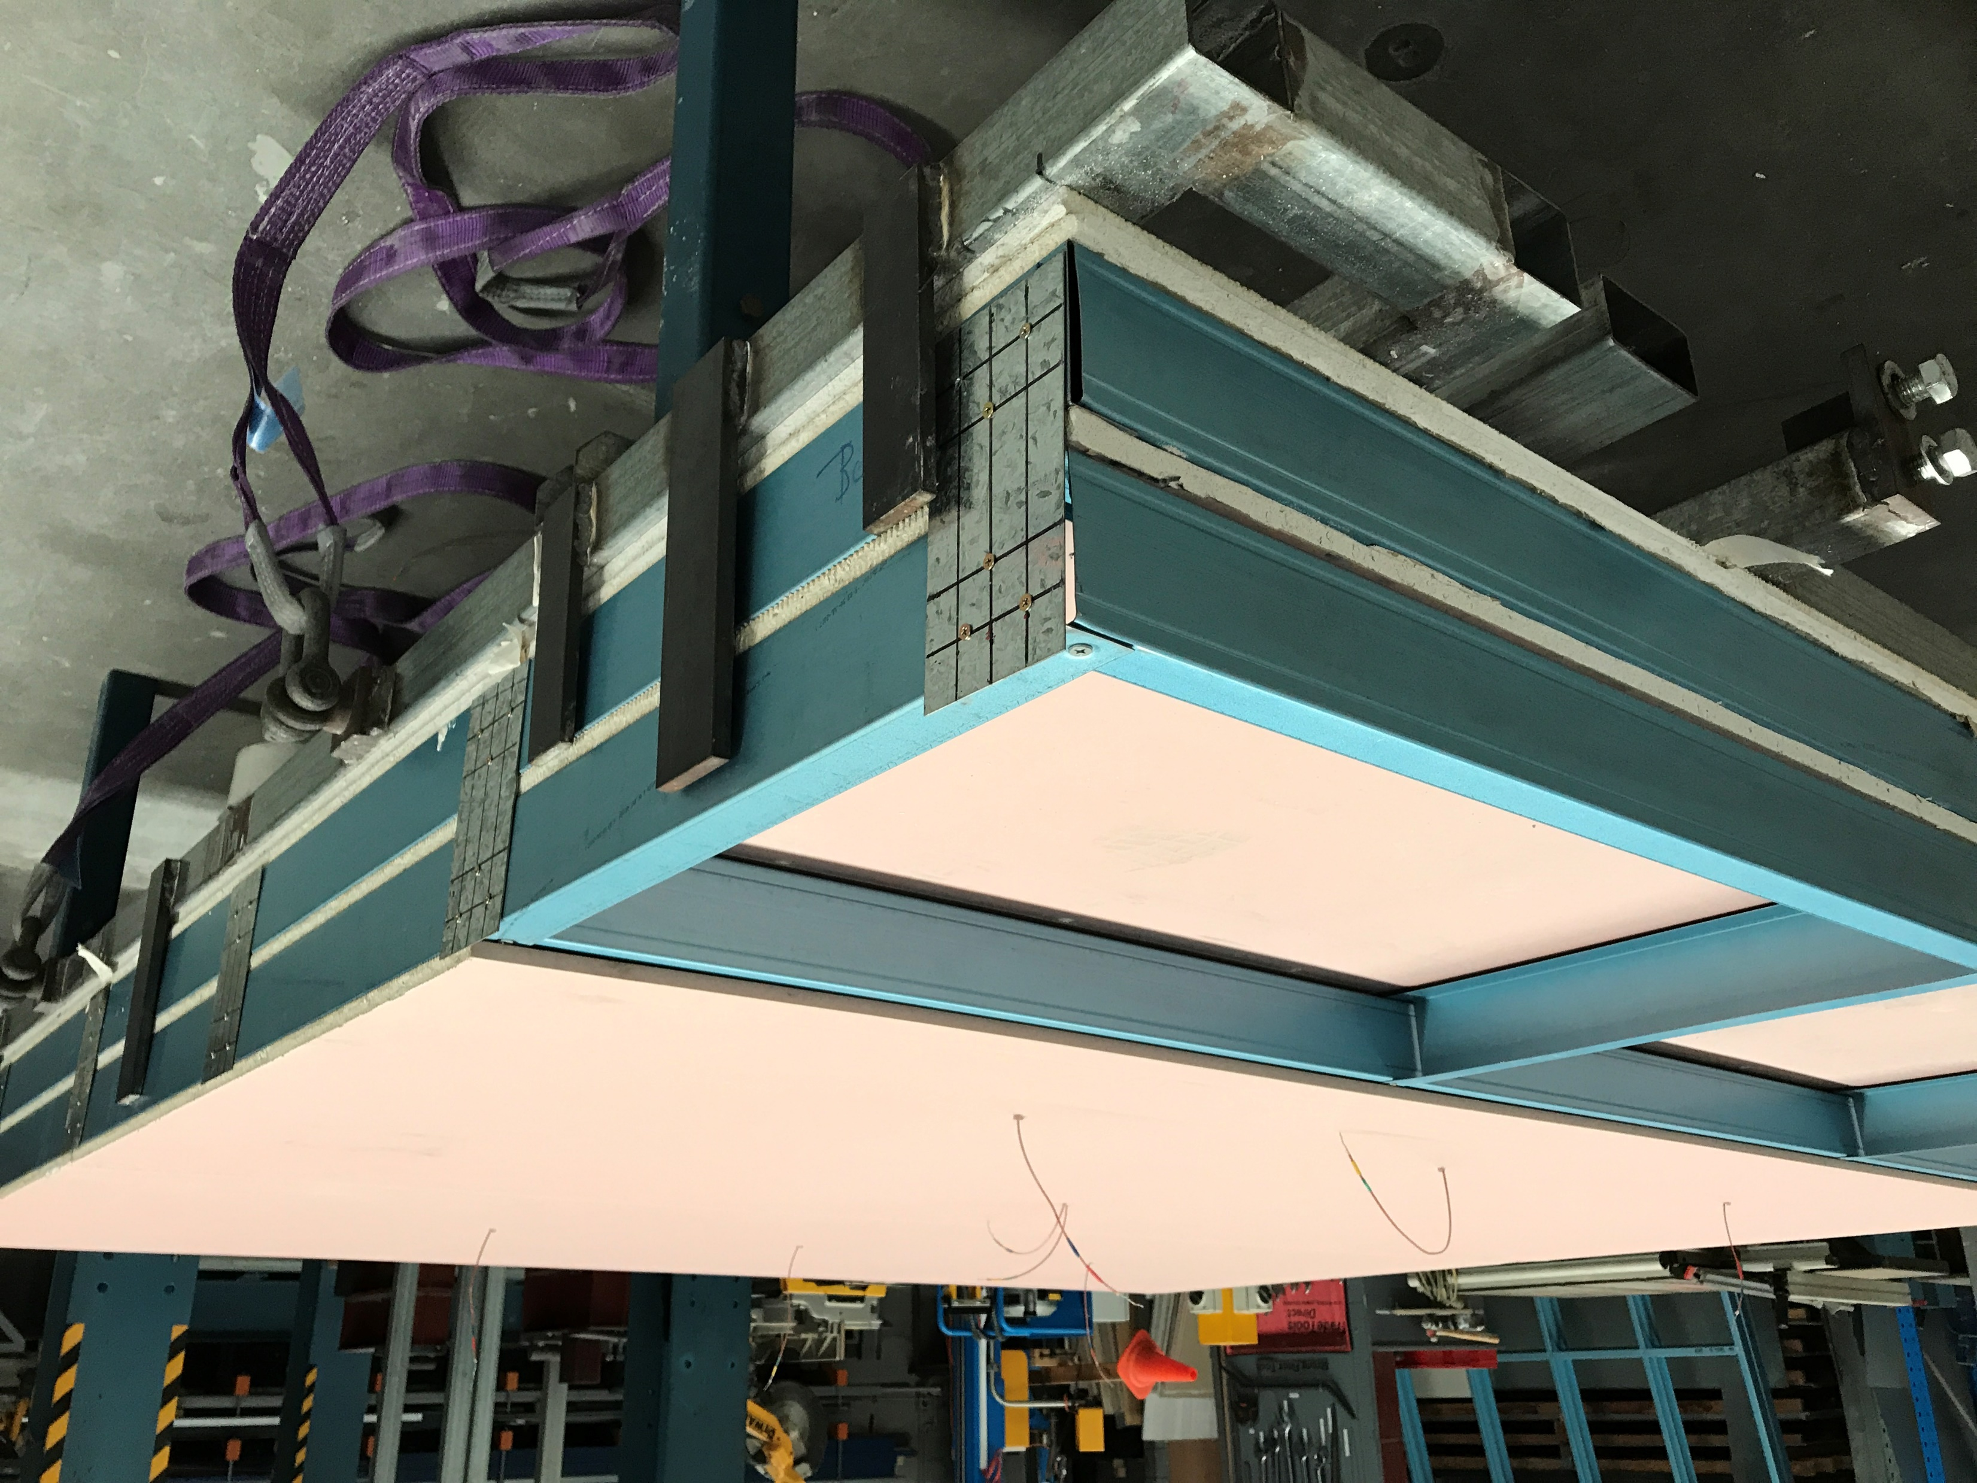
Fire side
plasterboard
Nogging
Plasterboard between the studs
Stud-Row1
Track1
Stud-Row2
Track2
Notes:
T8-construction

Slide 11
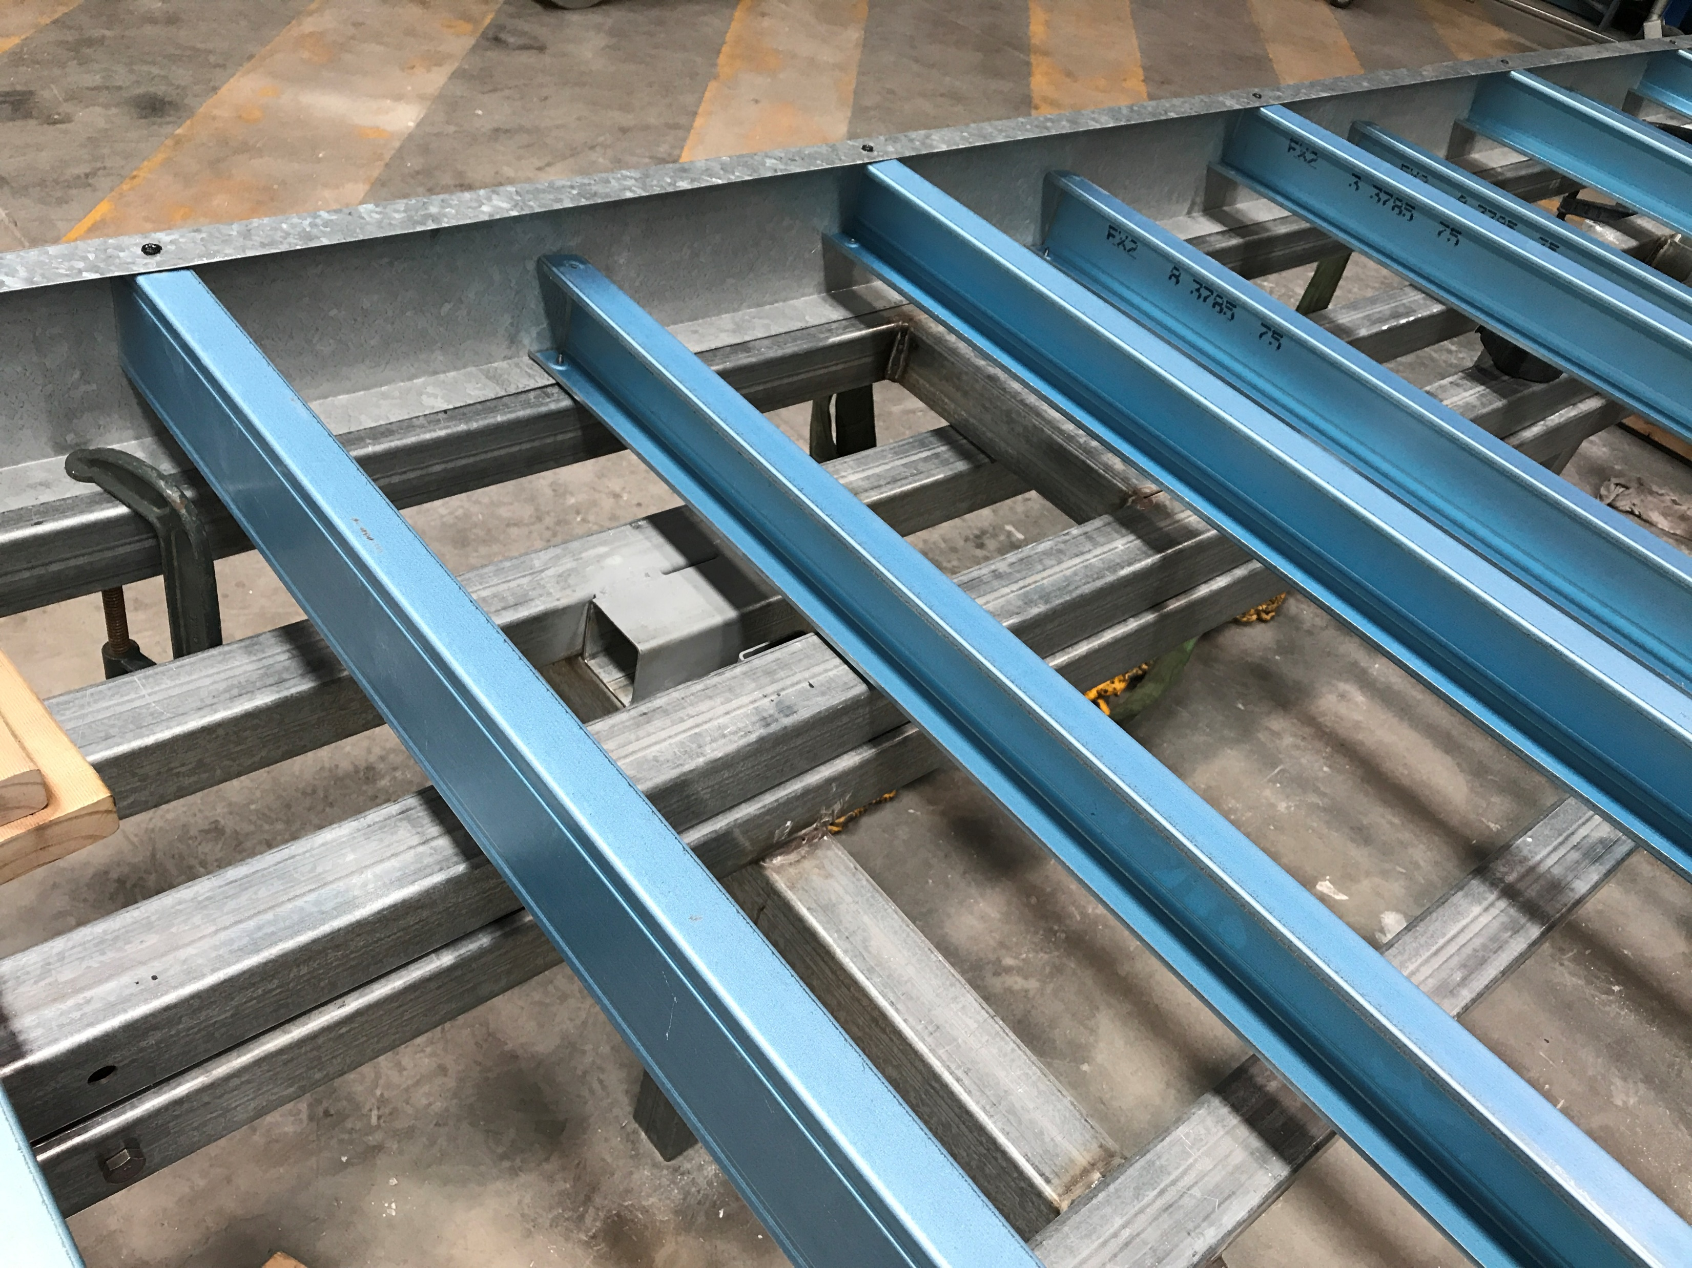
600 mm
Track
300 mm
Staggered stud arrangement
Notes:
T9-construction

Slide 12
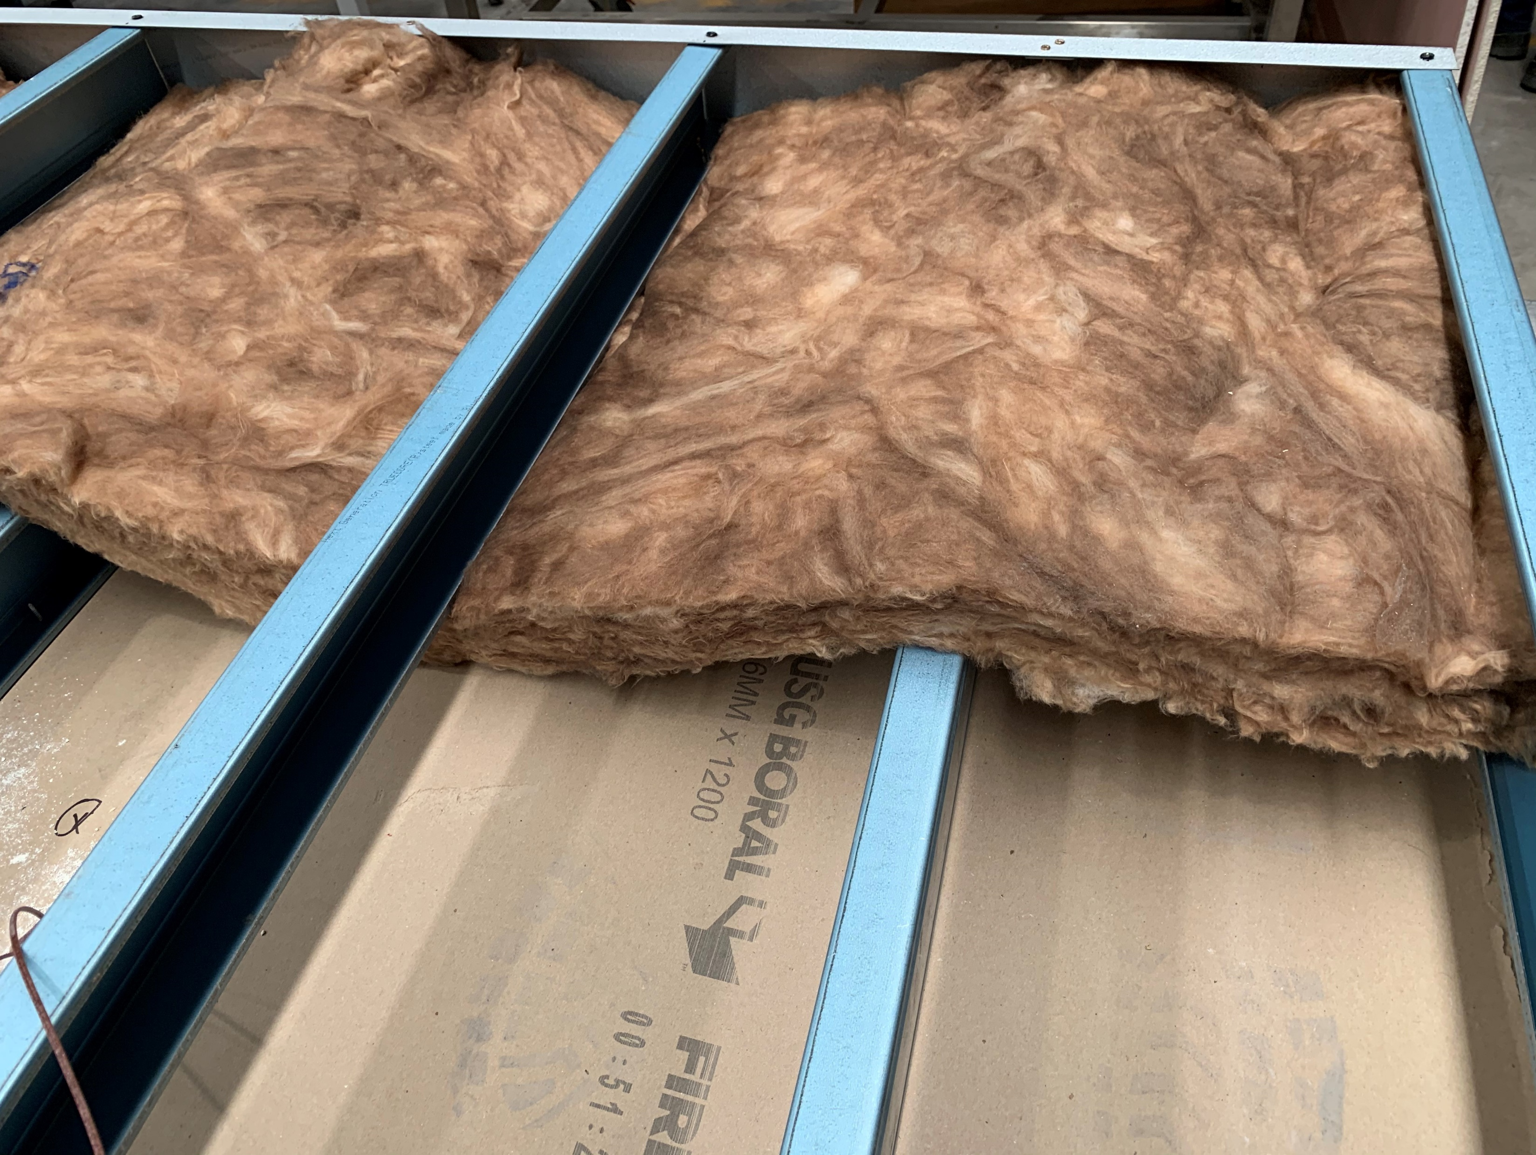
600 mm
300 mm
Insulation through alternate studs
Notes:
T10-construction

Slide 13
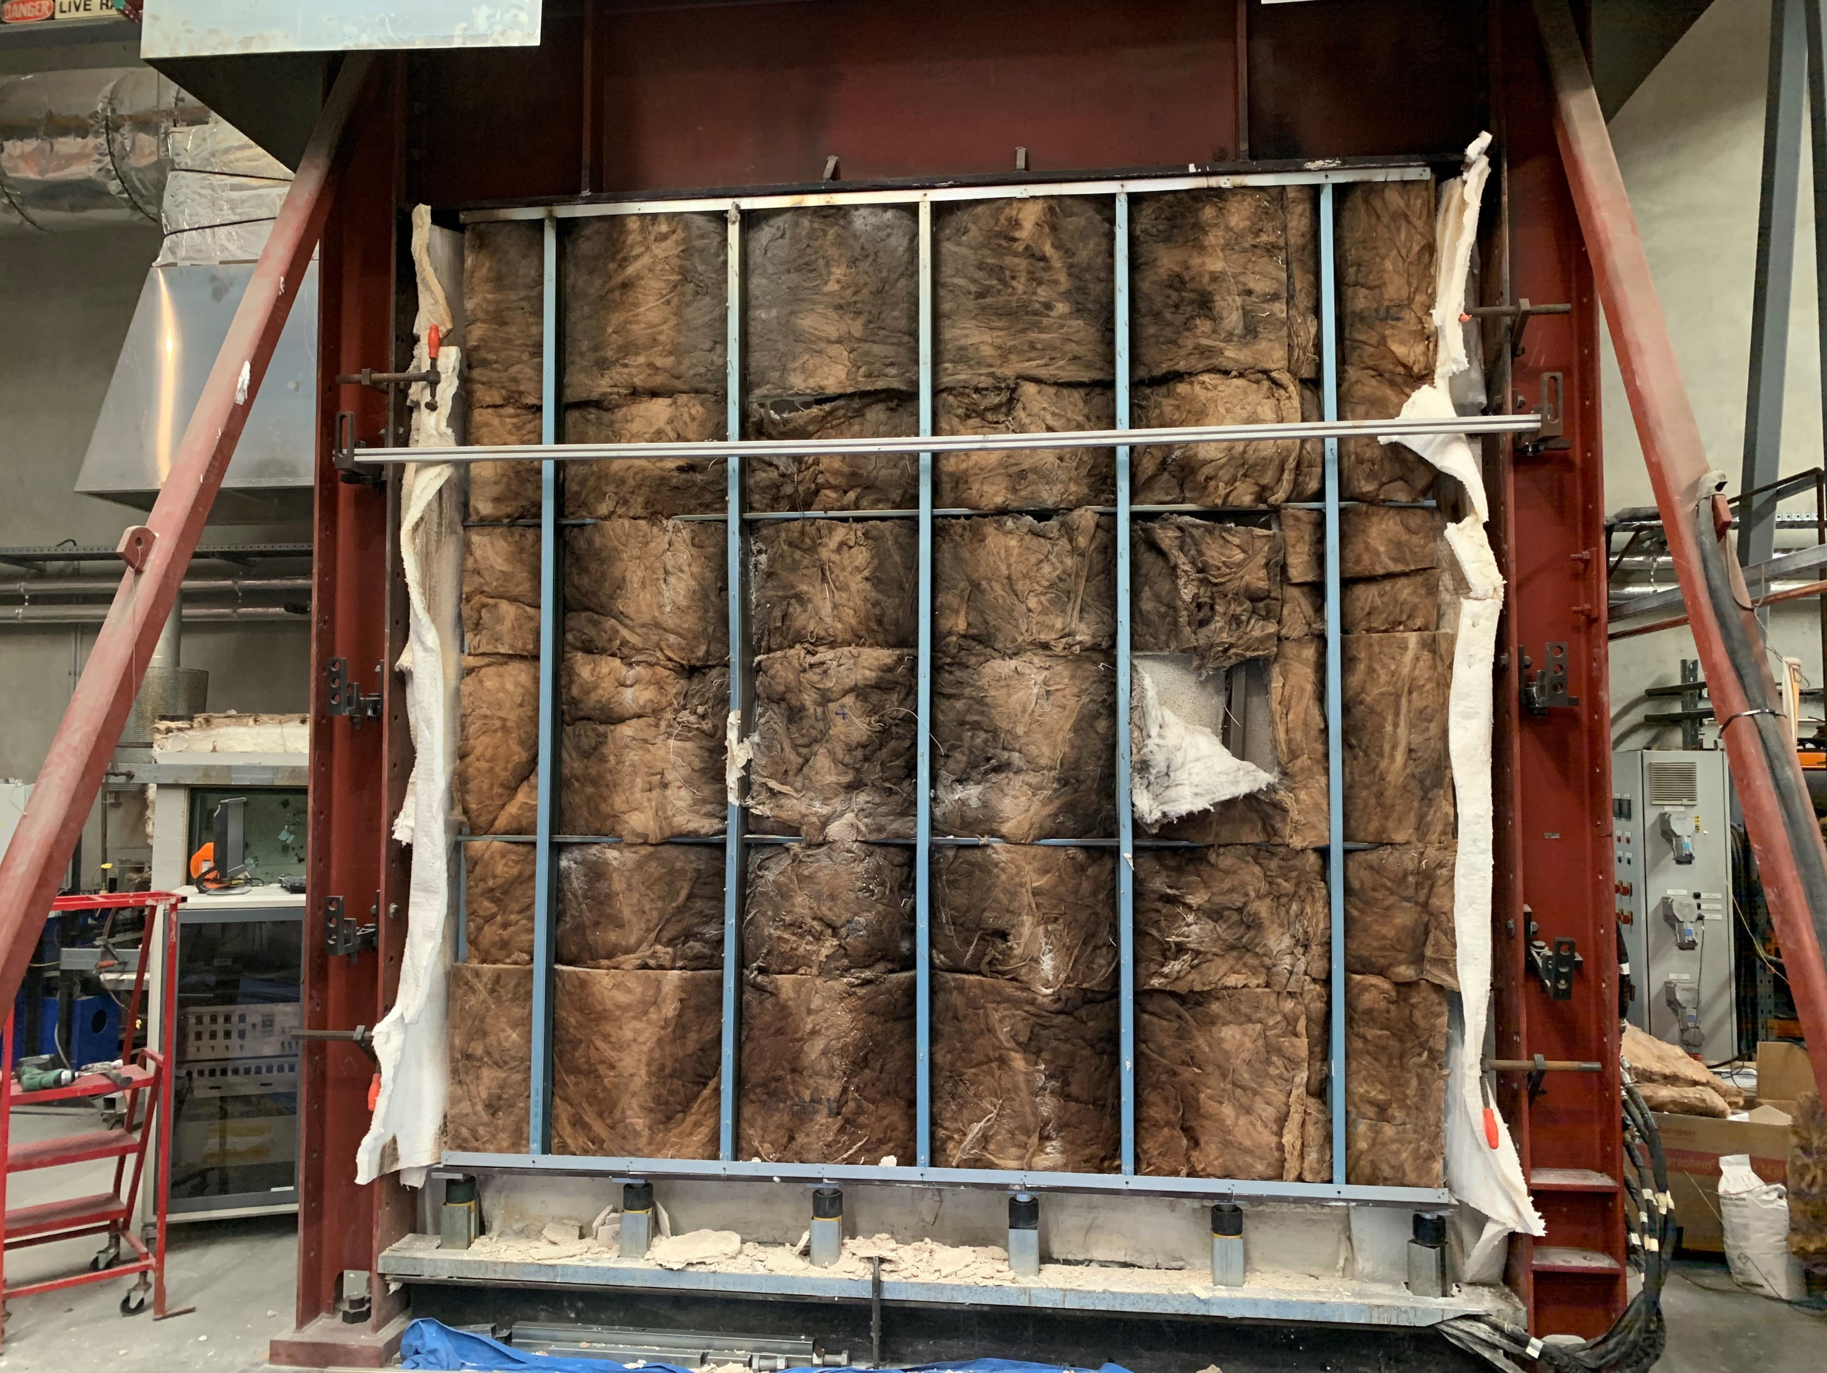
Ambient studs
Burnt insulation fire side
Heat entrapped at Stud locations
Unaffected insulation
Notes:
T10-burnt_insulation

Slide 14
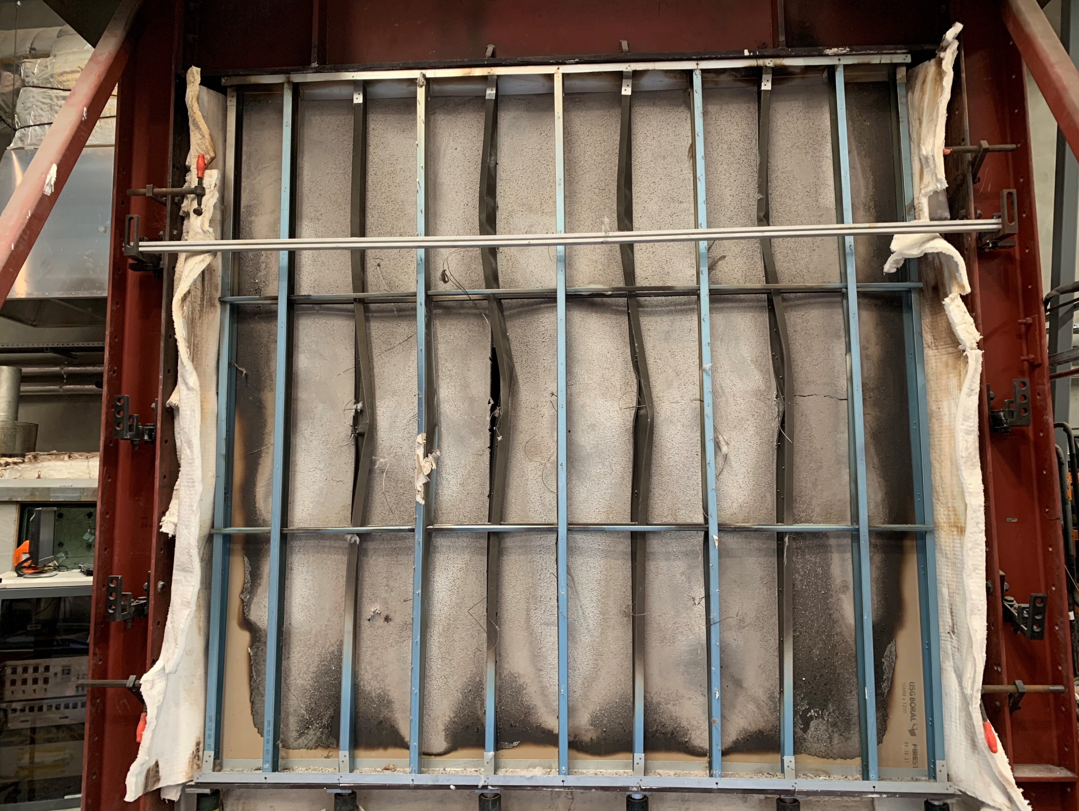
Unaffected ambient studs
Buckled fire side studs
Notes:
T10-stud_buckling

Slide 15
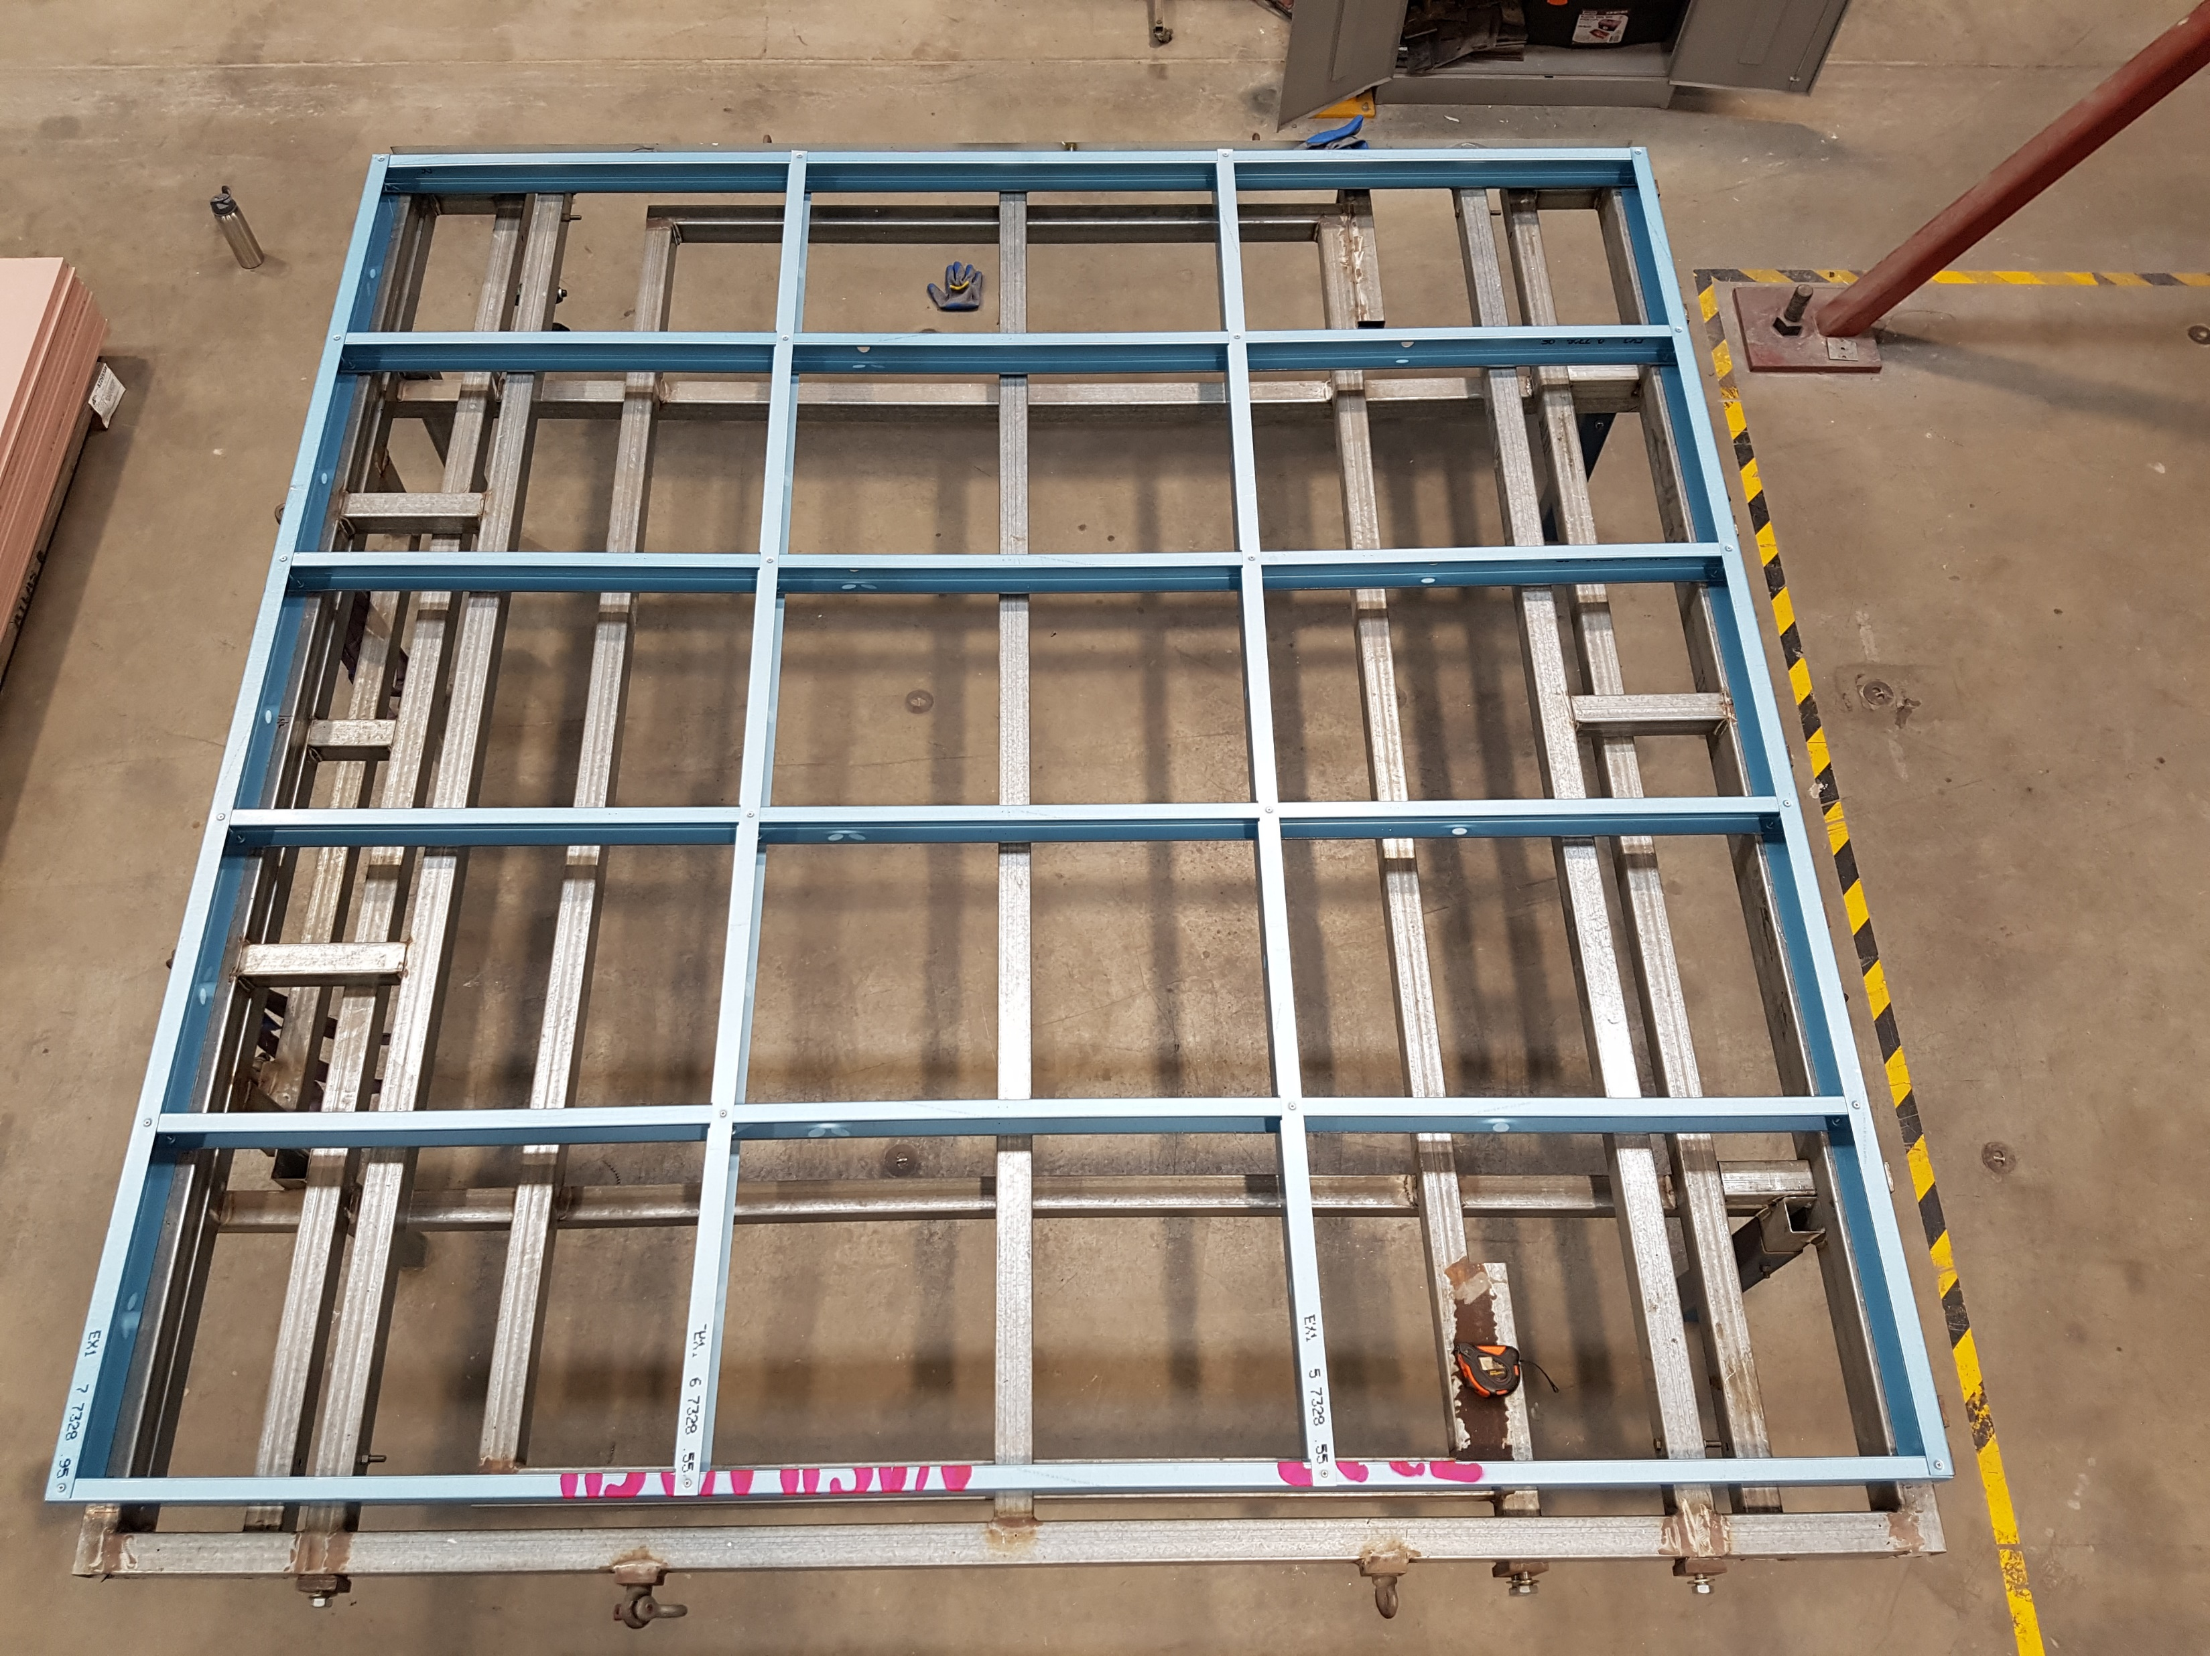
Track
Frame assembly on construction table
Nogging
Studs
Studs
Track
Notes:
T1-frame

Slide 16
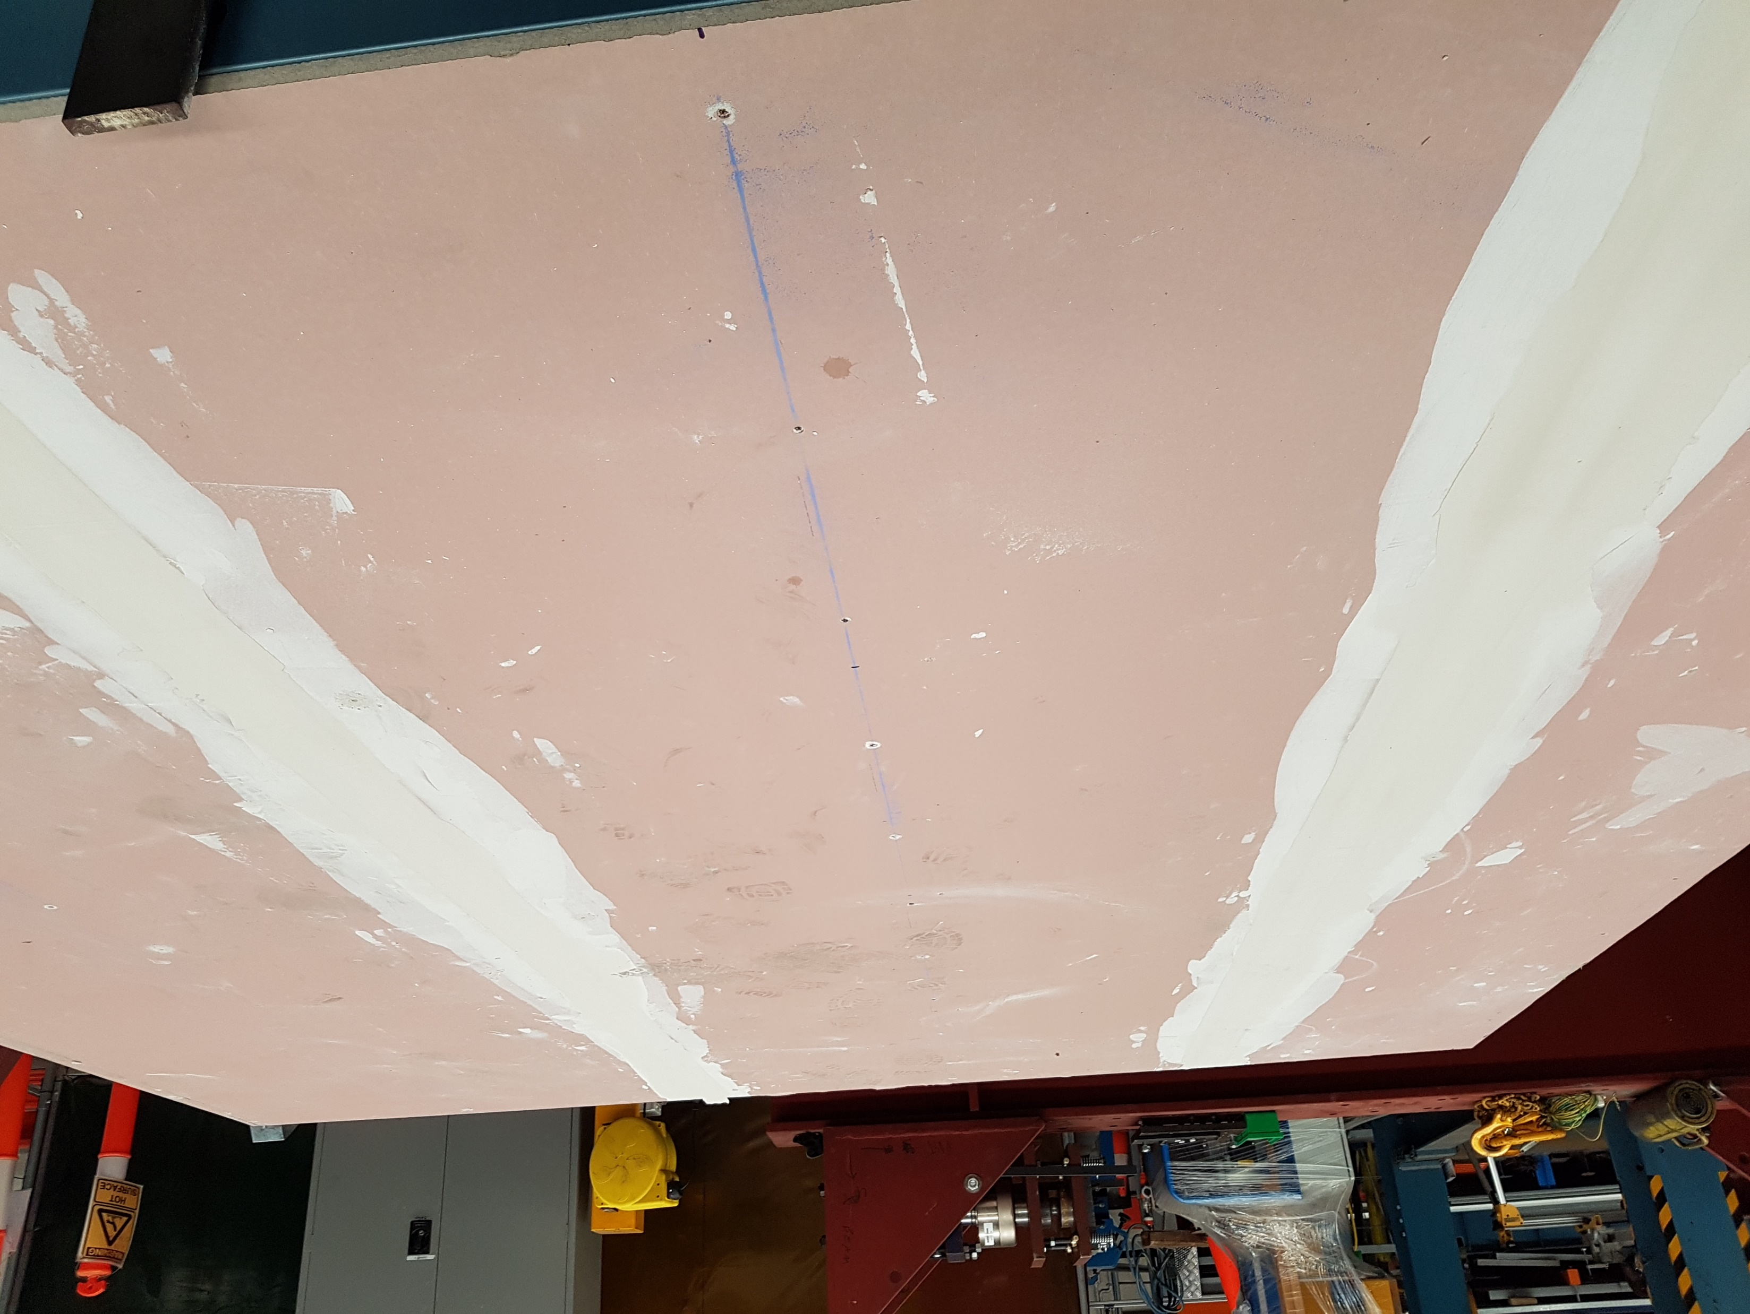
Plasterboard joint
Notes:
T1-pb-joint

Slide 17
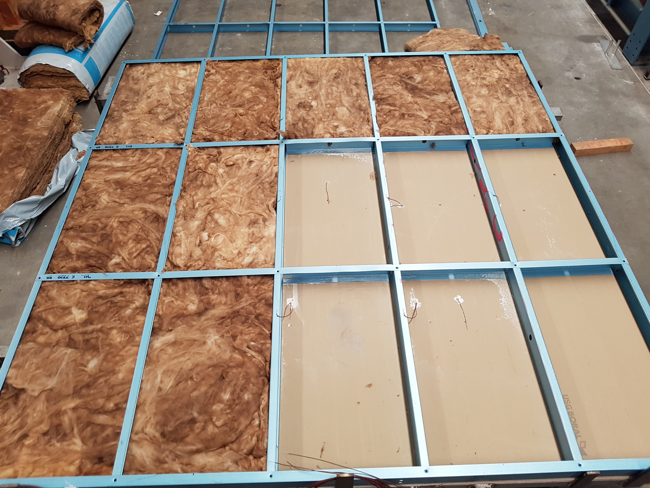
Track
Nogging
Cavity insulation installation
Studs
Track
Notes:
T5-construction-insulation

Slide 18
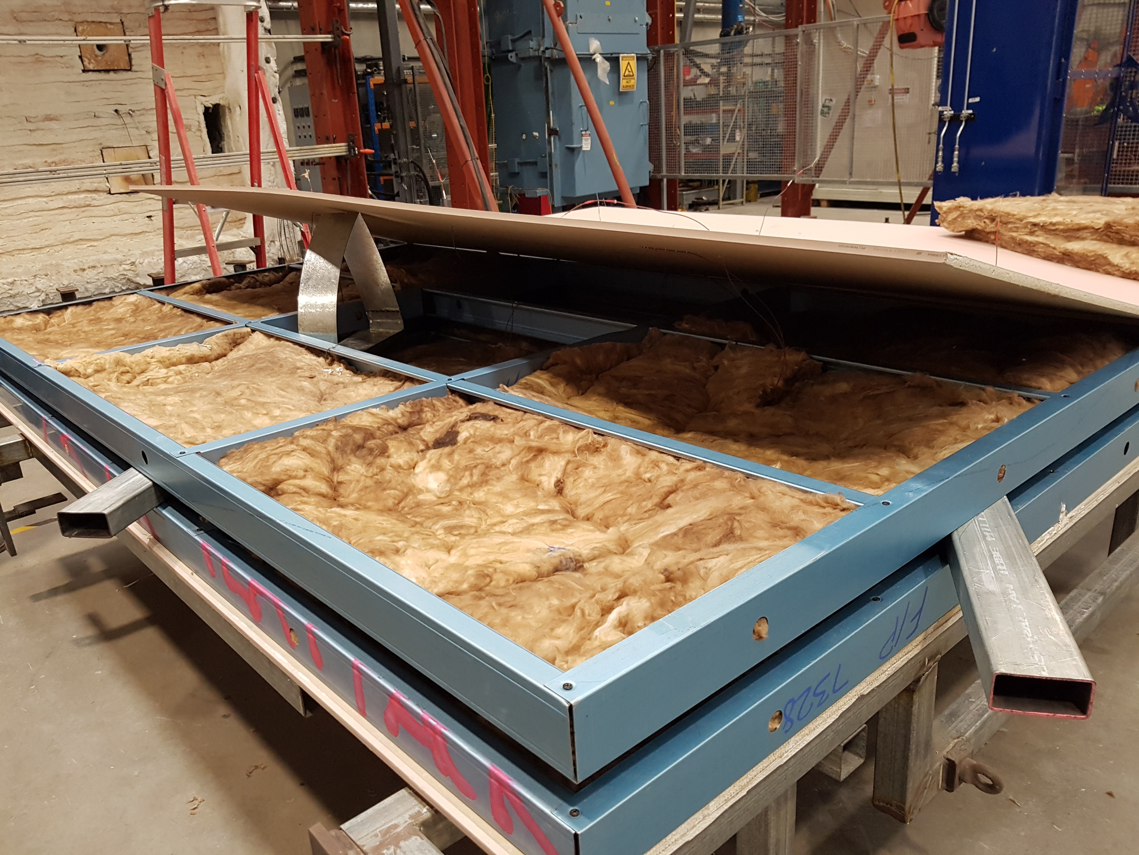
Notes:
T5-construction-insulation-built

Slide 19
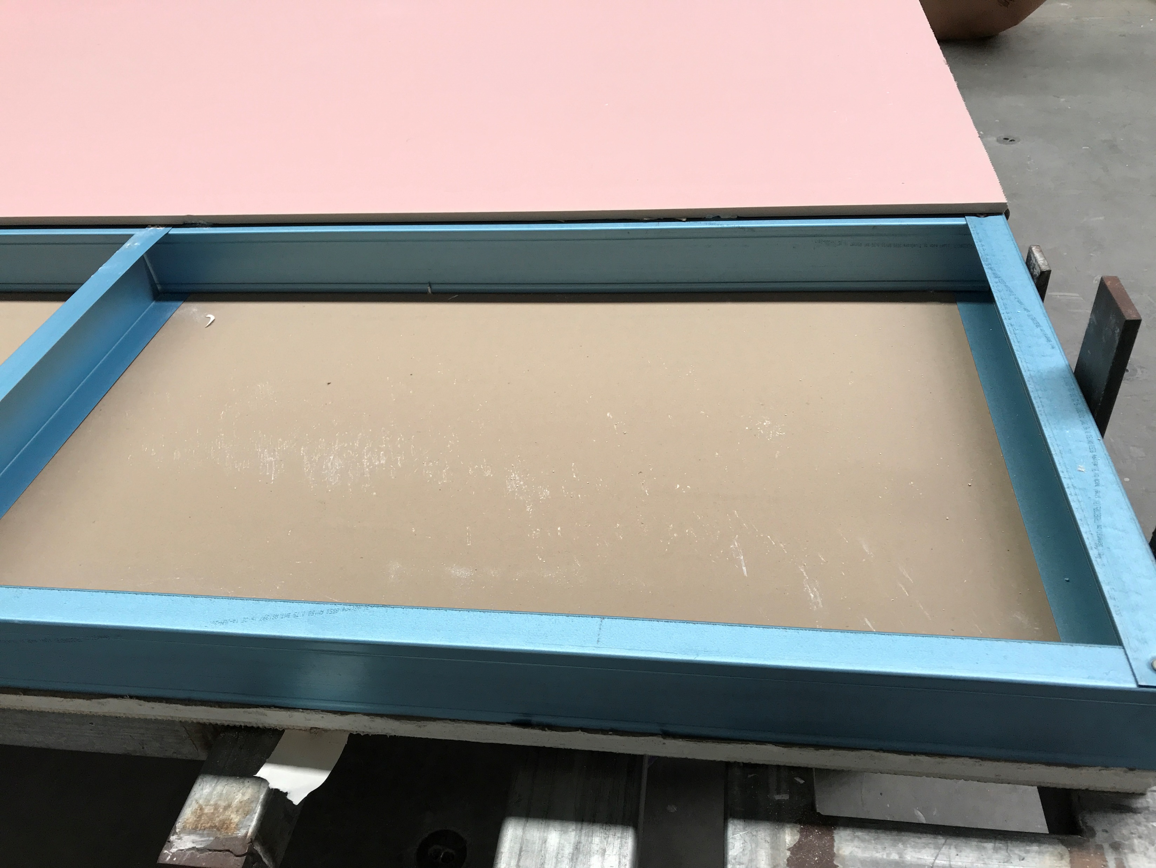
Notes:
T8-construction-layer1

Slide 20
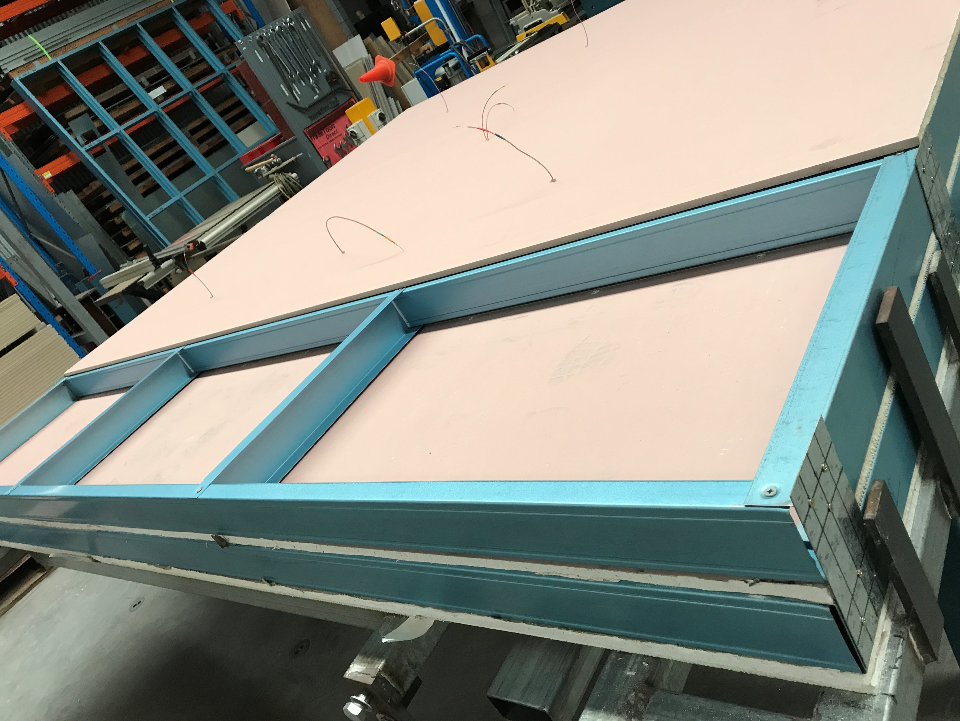
Notes:
T8-construction-layer2

Slide 21
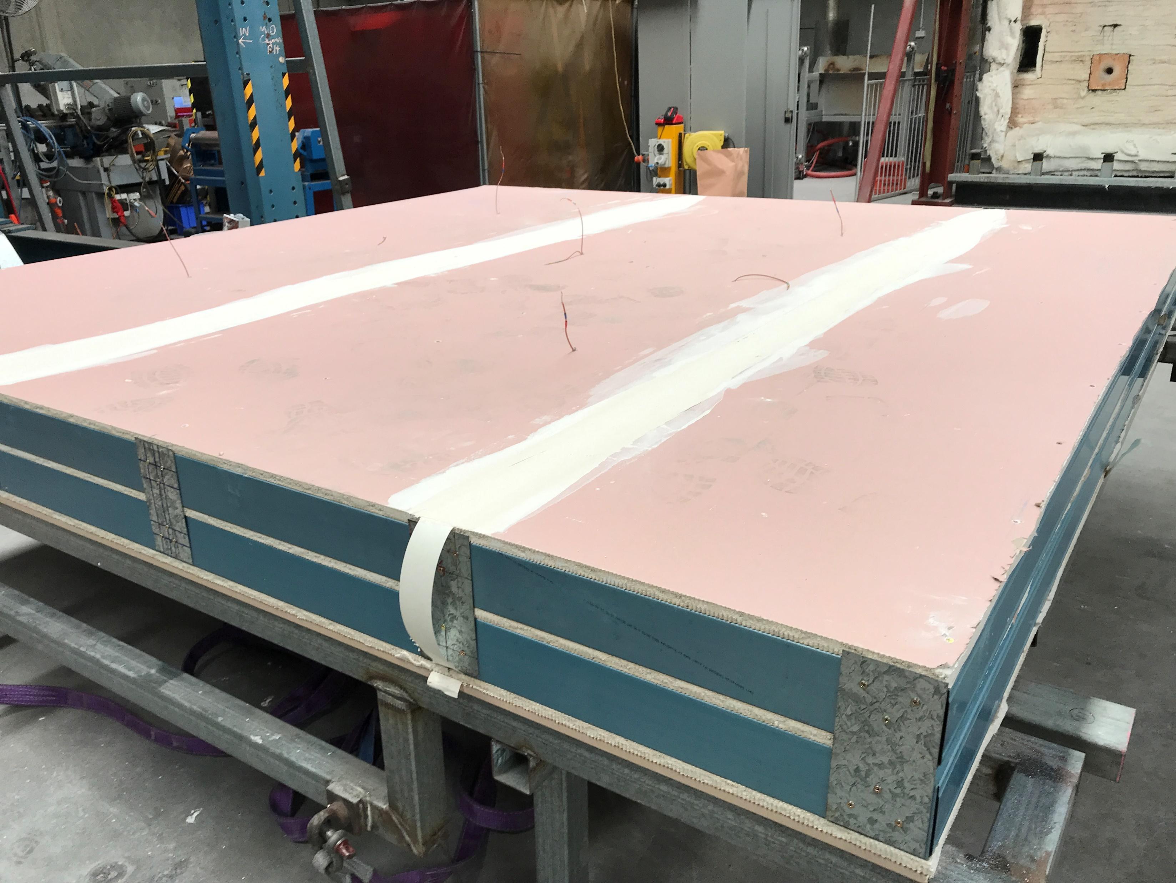
Plasterboard joint
Notes:
T8-construction-built

Slide 22
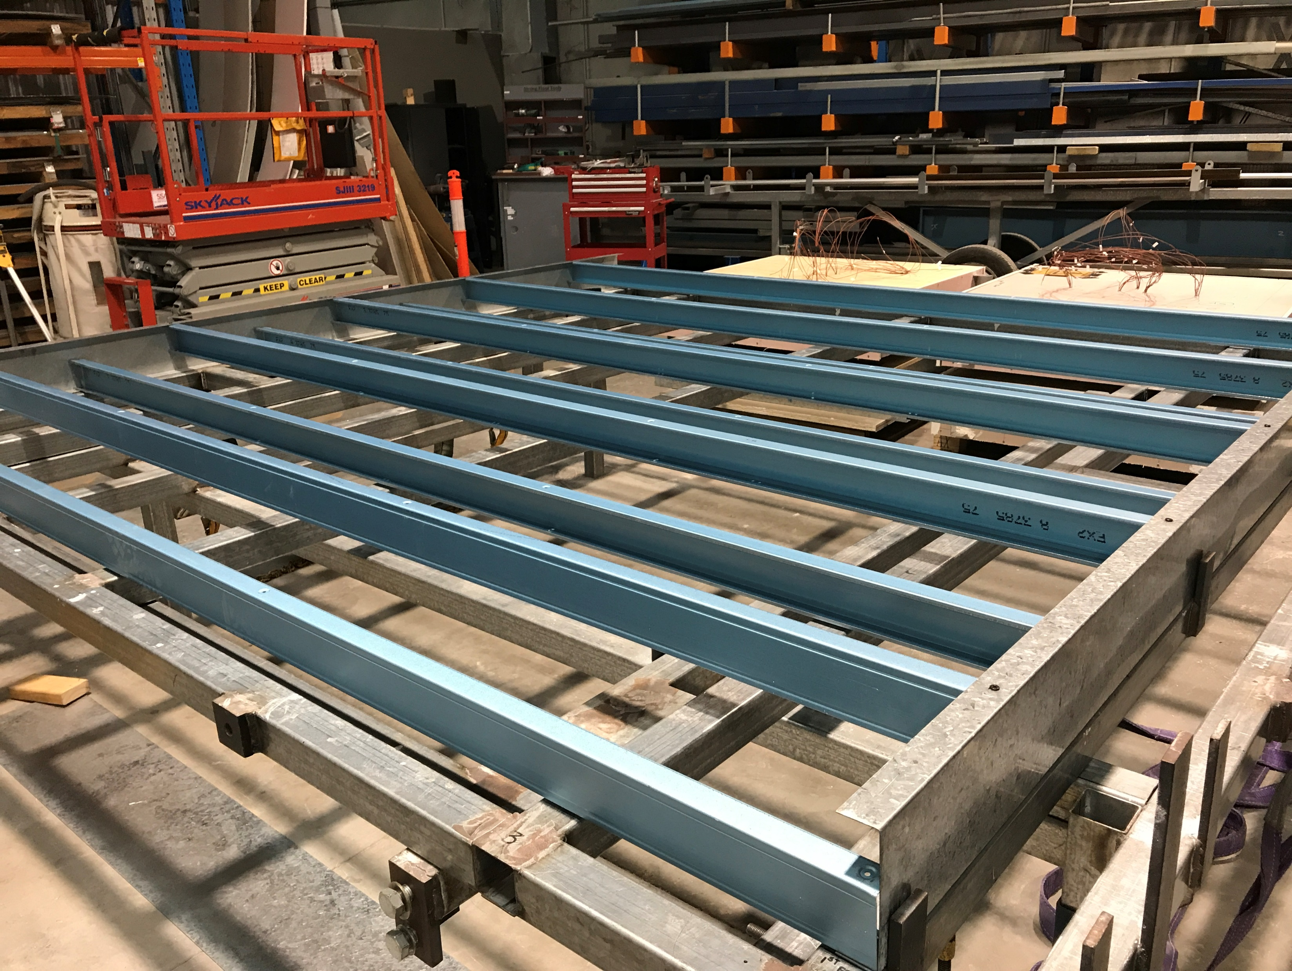
Staggered stud arrangement
Track
Notes:
T9-frame

Slide 23
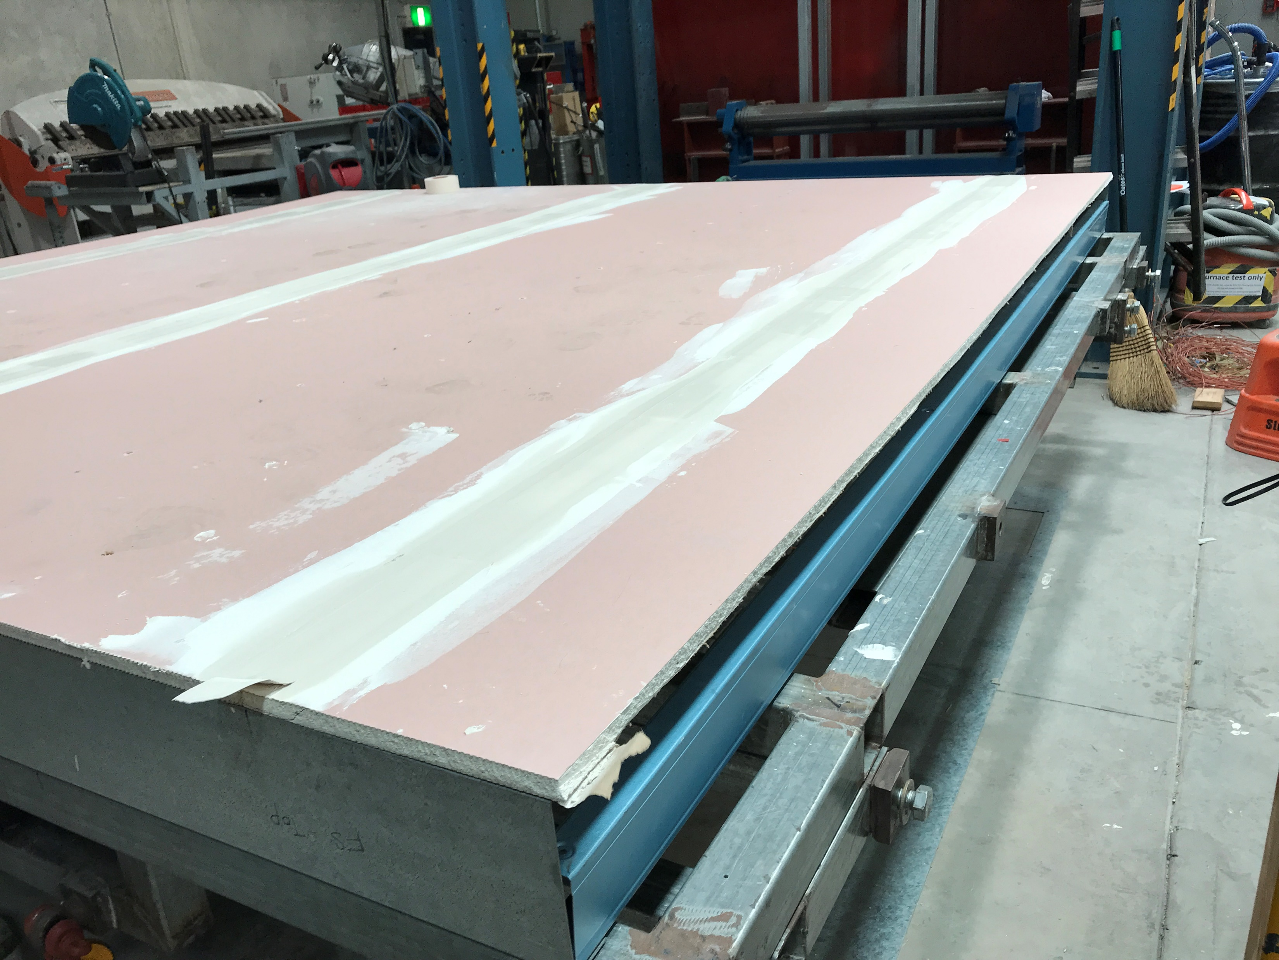
Plasterboard joint
Notes:
T9-construction-built

Slide 24
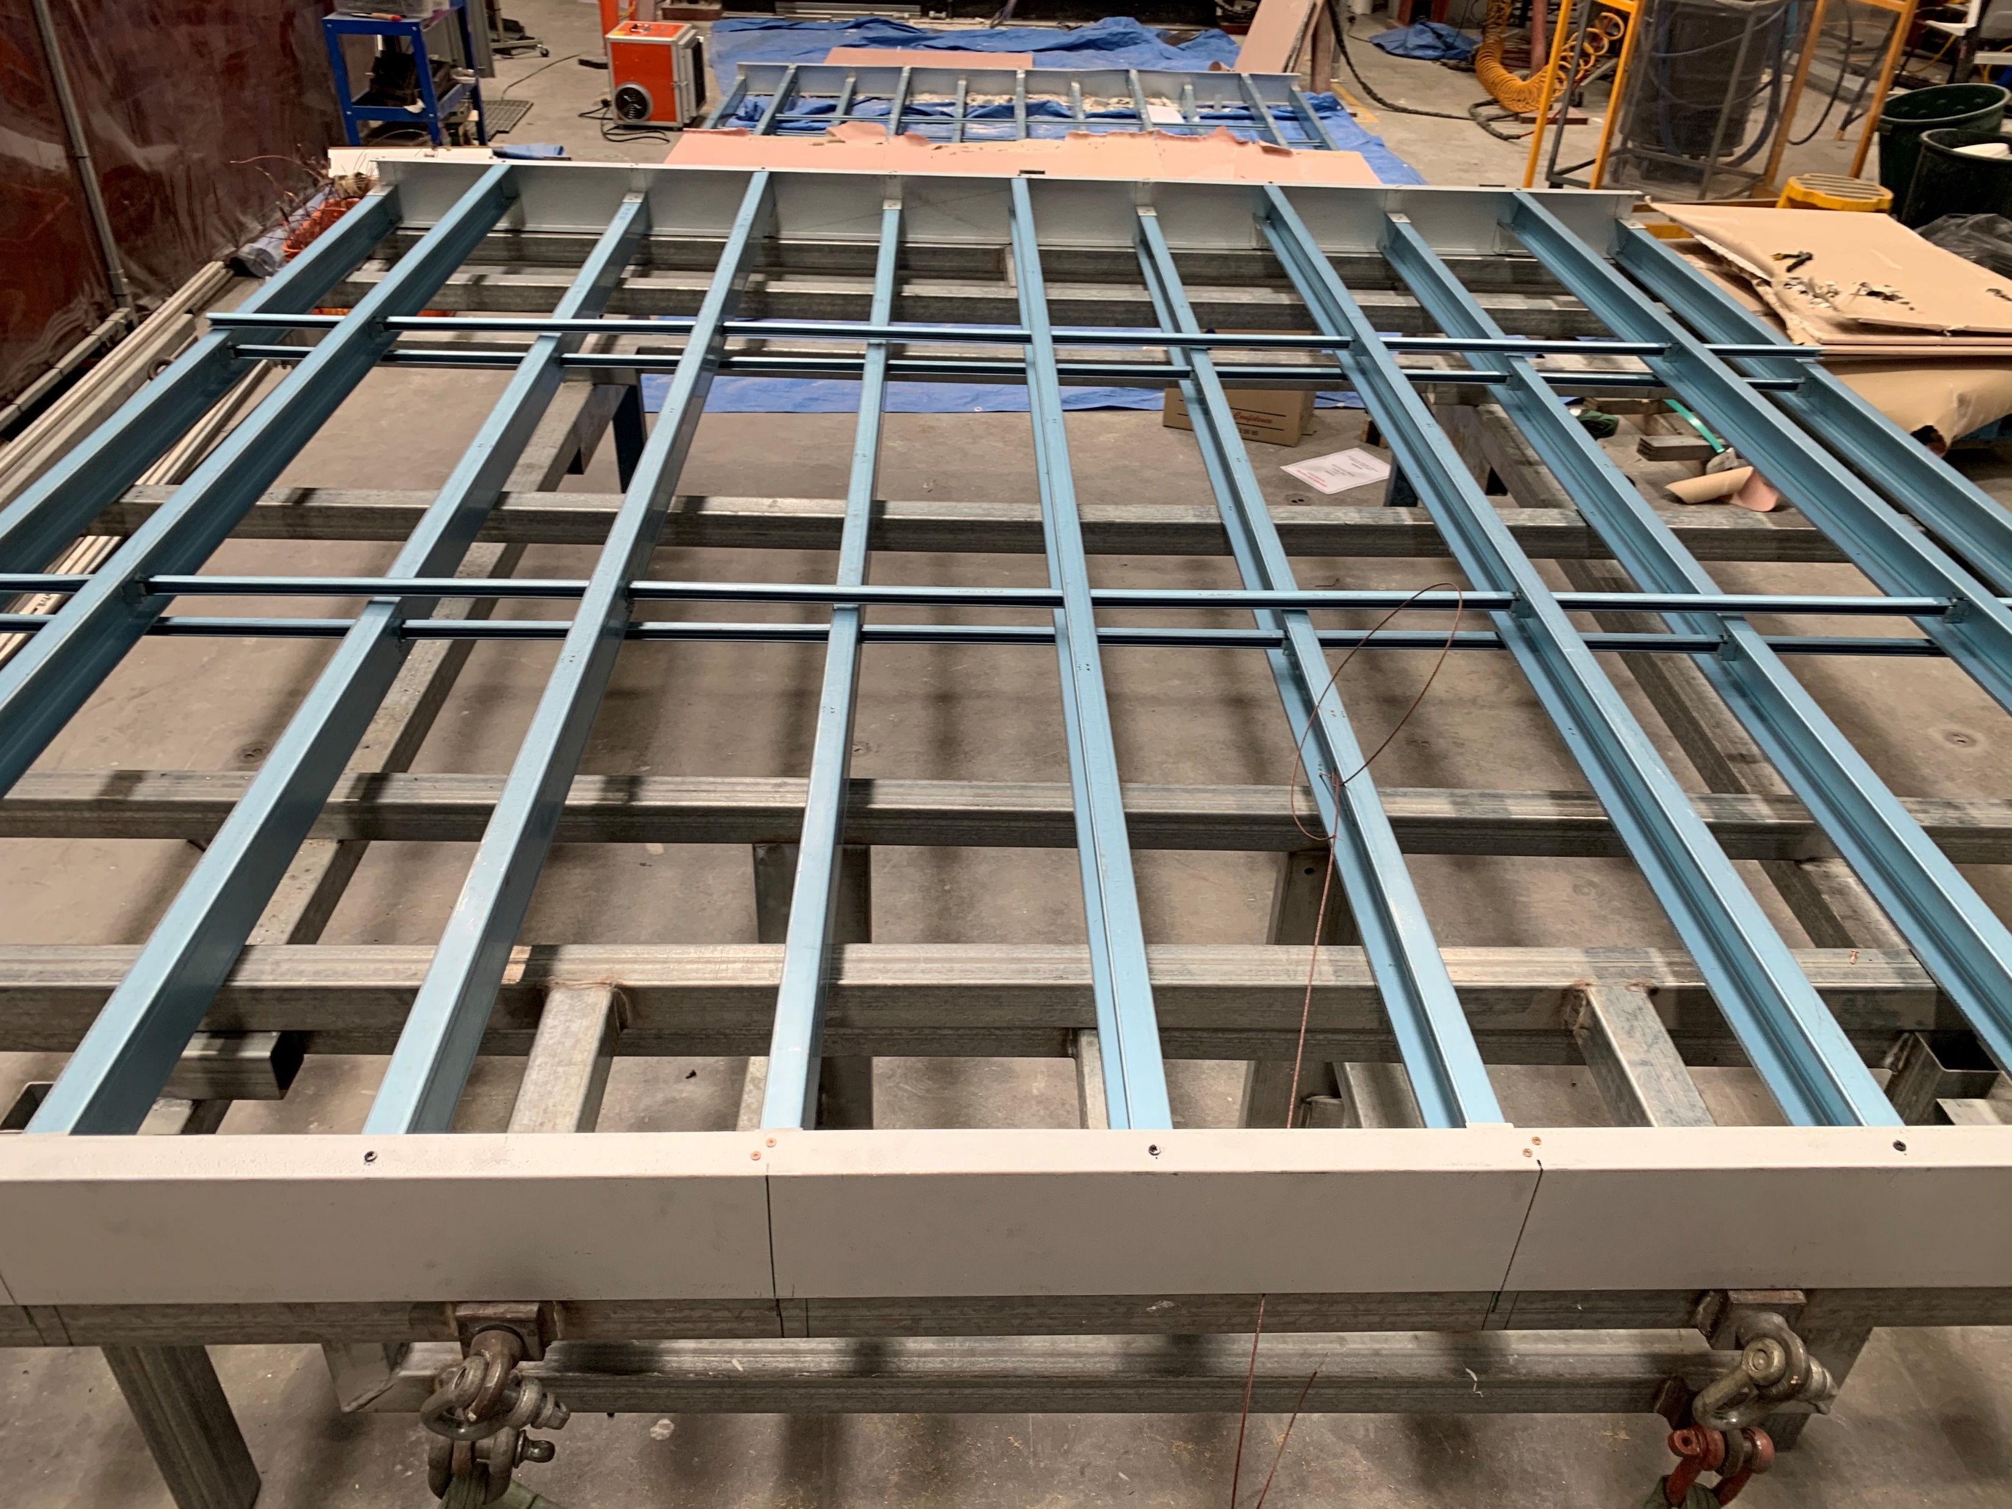
Omega nogging
Staggered stud arrangement
Track
Notes:
T10-frame

Slide 25
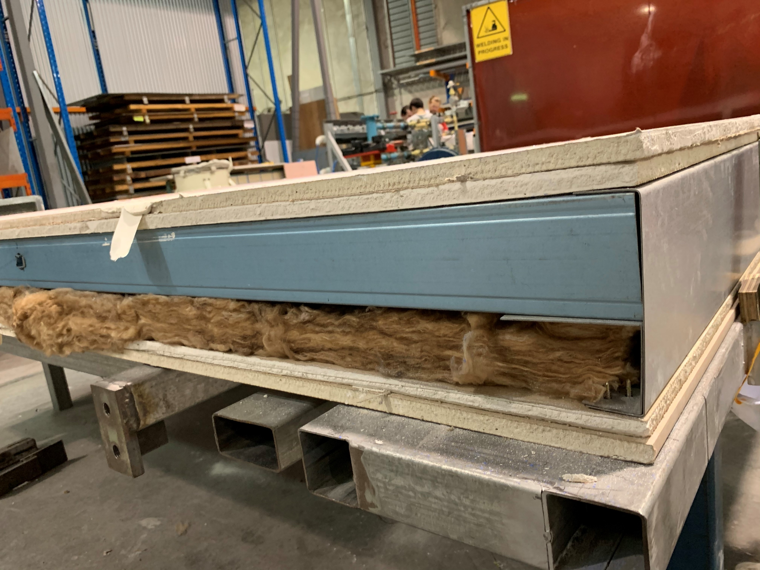
Plasterboard
Stud
Track
Insulation
Plasterboard
Notes:
T10-construction-built

Slide 26
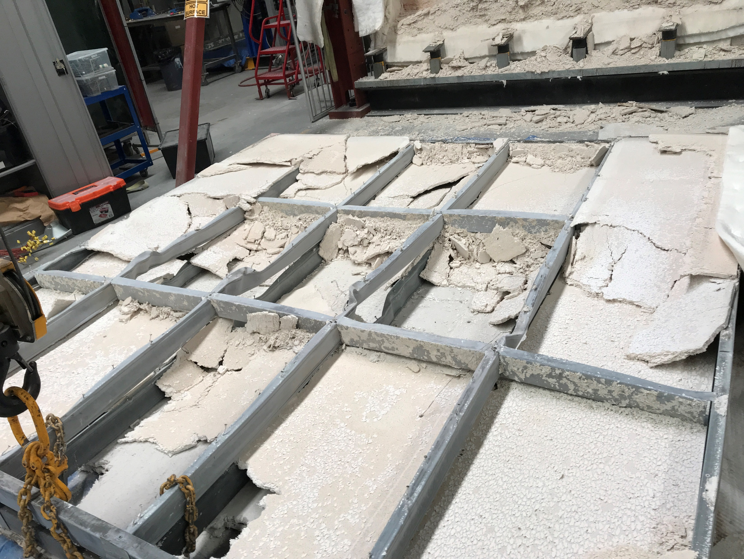
Fully calcinated fire side plasterboard Pb1, Pb2 and Pb3
Intact Pb3

